Slide 1
Surgery
Asst. prof. wipakon sonsnam​

Slide 3
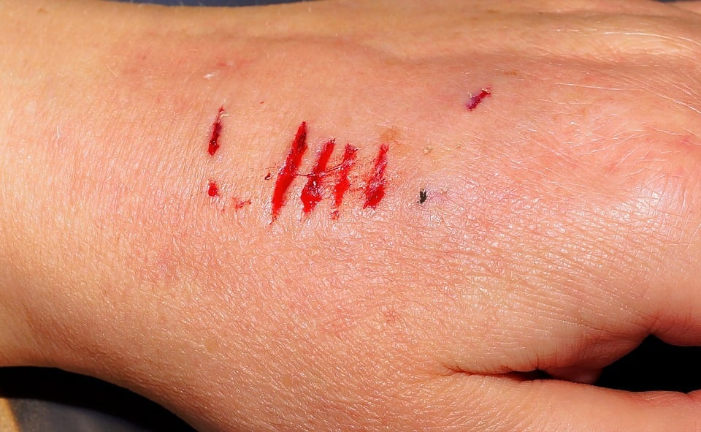
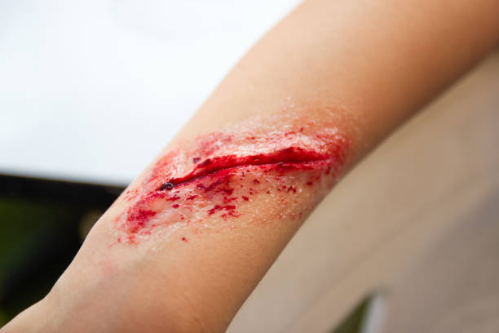
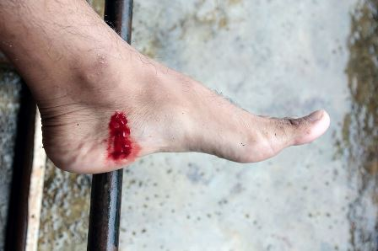
wound
What is a wound
Types of wound
Asessment

Slide 4
what is a wound
A wound is any type of damage or breakage on the surface of the skin. The wounds can be due to accidents like burns, paper cuts, skin tears or surgical, any underlying disease, or some other skin conditions that may develop in the wound, for example, eczema or psoriasis.

Slide 5
Type of wounds

Slide 6
Open or Closed
Wounds can be open or closed. Open wounds are the wounds with exposed underlying tissue/ organs and open to the outside environment, for example, penetrating wounds. On the other hand, closed wounds are the wounds that occur without any exposure to the underlying tissue and organs.

Slide 7
Acute or Chronic
A wound can be classified as acute or chronic depending on the healing time. Acute wounds are those that heal without any complications in a predicted amount of time. While chronic wounds, on the other hand, are those that take a relatively long time to heal with some complications.

Slide 8
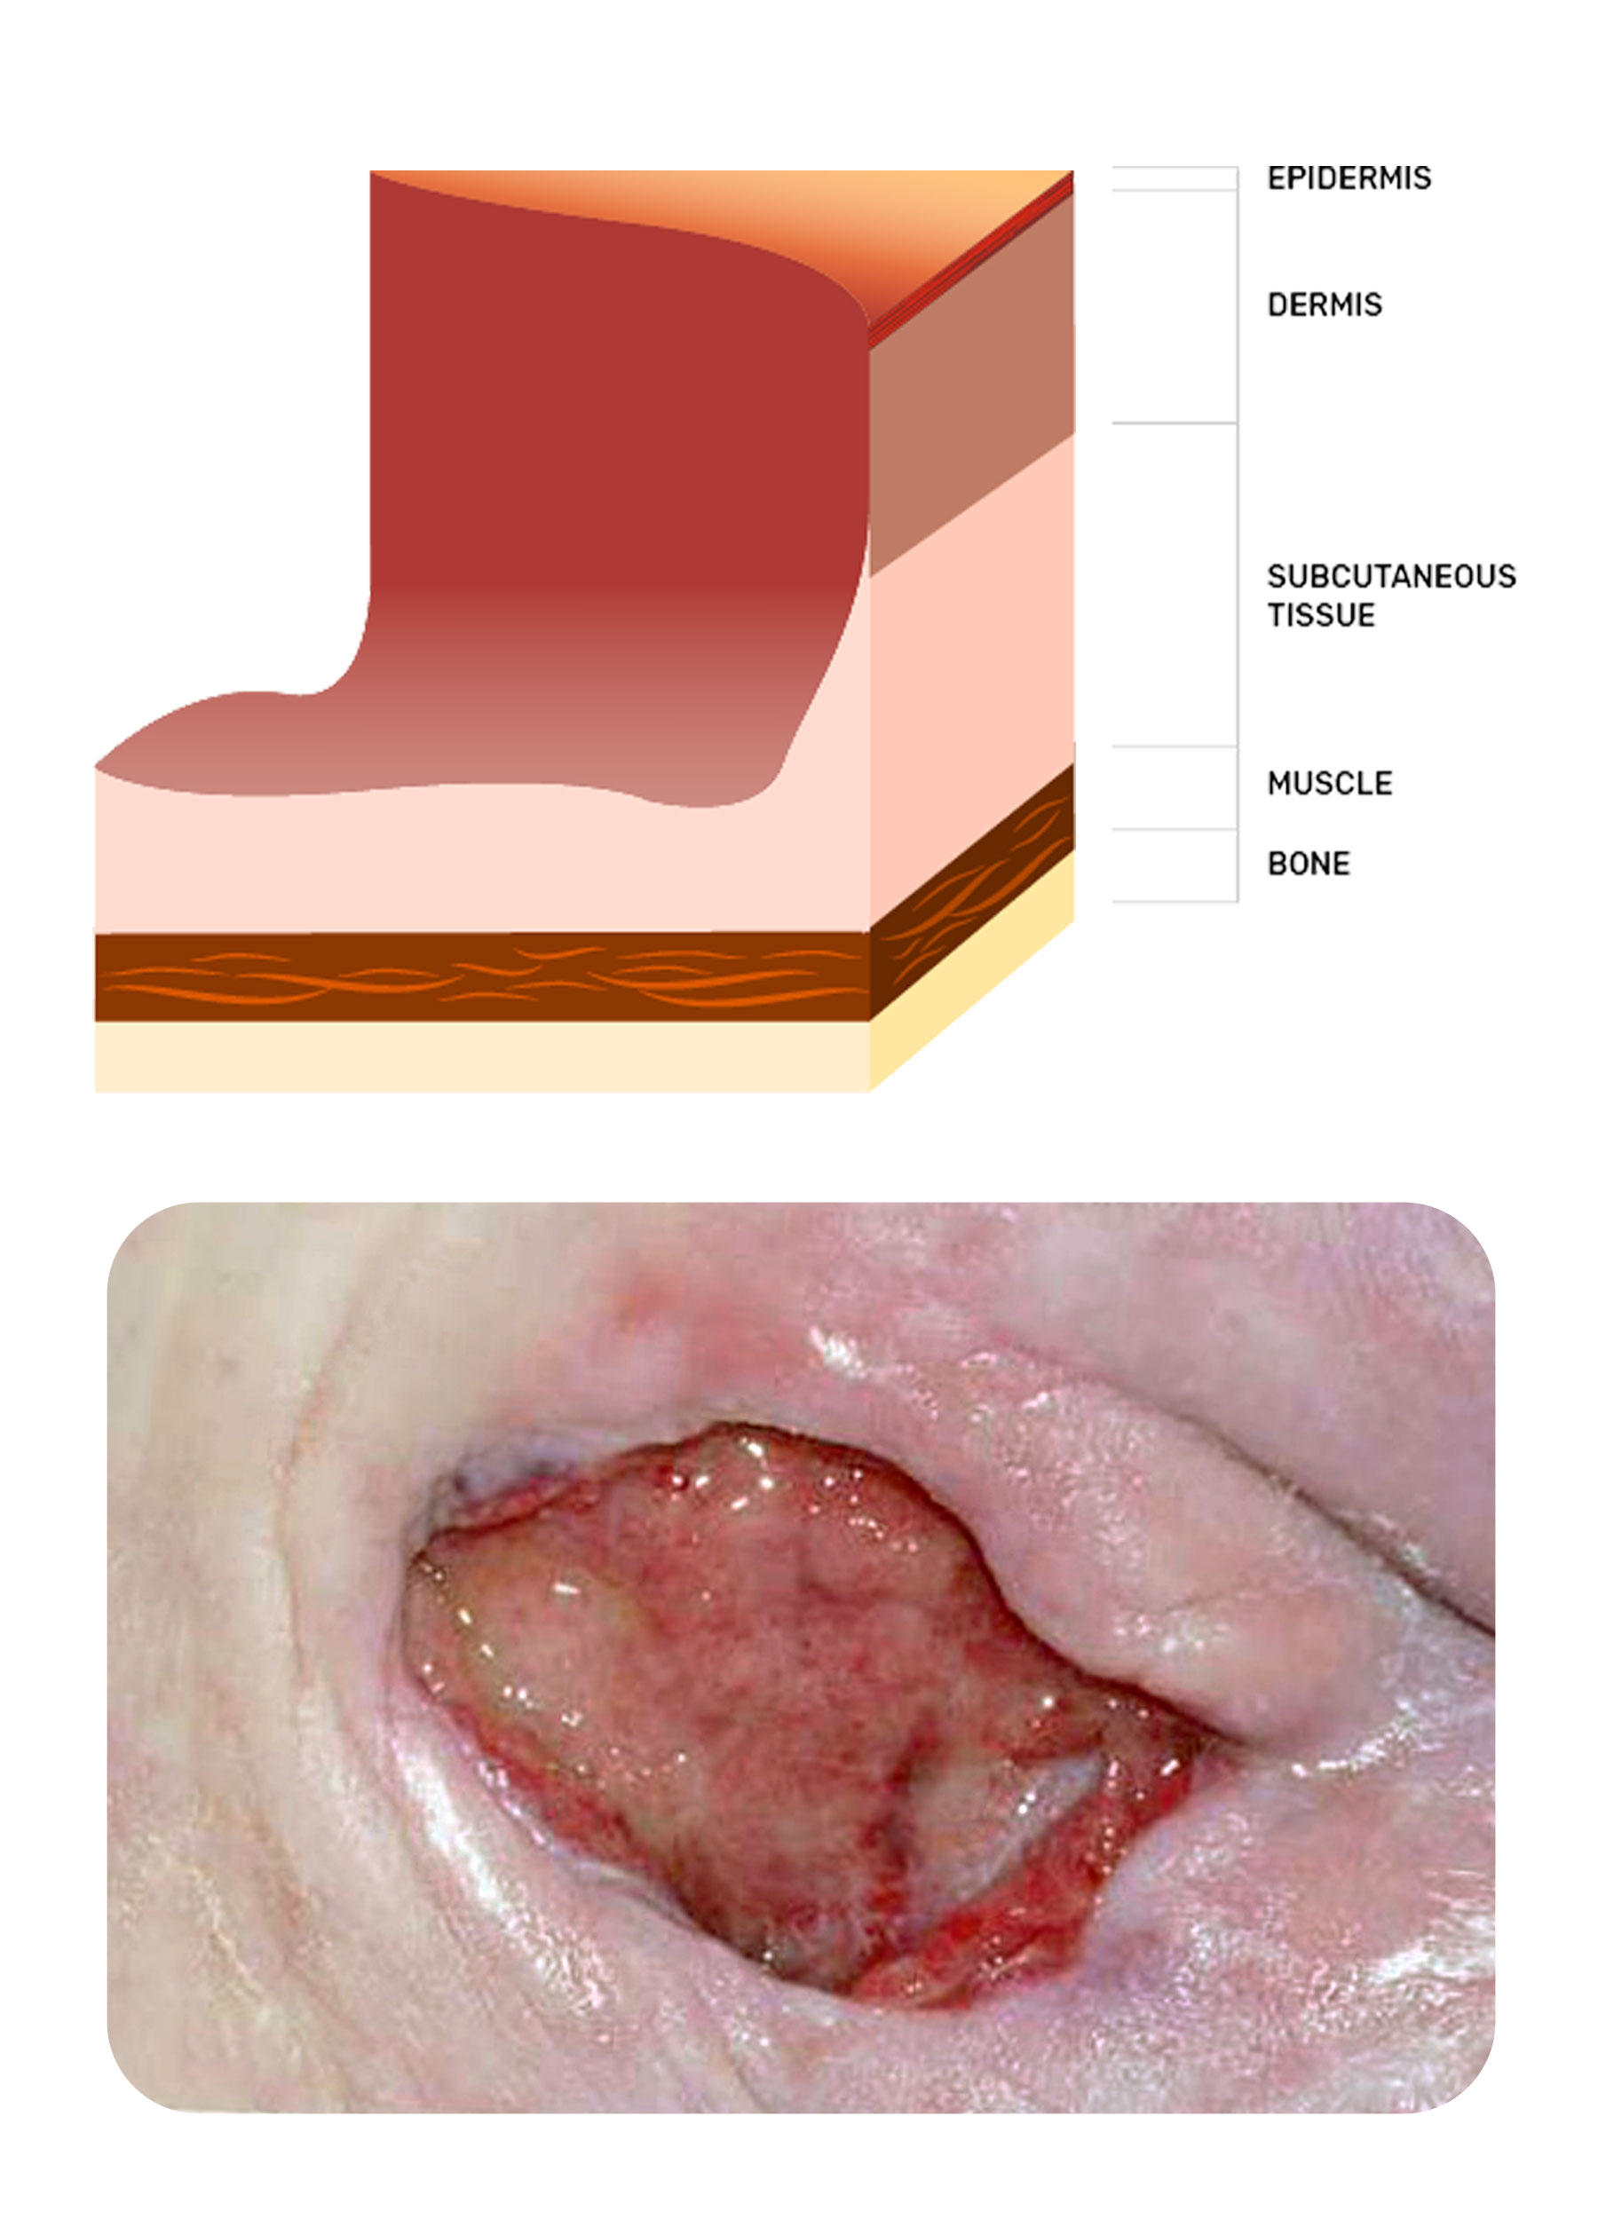
Types of Chronic Wounds 1. Pressure Injuries 2. Diabetic Ulcers

Slide 9
Clean or Contaminated
Wounds can also be classified on the basis if they are clean or contaminated. Clean wounds are those that do not have any foreign material or debris inside whereas contaminated wounds or infected wounds are those that might have some dirt, bacteria, or other foreign markets. Pressure wounds can be used as an example of an open or closed wound depending on its current stage.

Slide 10
Internal or External
Wounds can also be internal or external. Internal wounds can be due to impaired circulation, nervous system functions, neuropathy or medical illness, or decreased supply of blood, oxygen, or other nutrients while the external wounds can be due to an outside force or trauma caused by penetrating objects or non-penetrating trauma.

Slide 11
Non-penetrating Wounds
aBRASIONS
Lacerations
BRUISES
CONCUSSIONS

Slide 12
Penetrating Wounds
Stab wounds
Cuts
Surgical wounds etc

Slide 13
ASSESSMENT WOUND

Slide 14
Full-Thickness

Slide 15
5 STEP OFWOND ASSESSMENT

Slide 16
Best practice in wound assessment

Slide 17
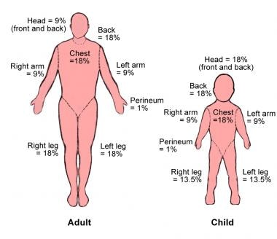
Burn assessment

Slide 18
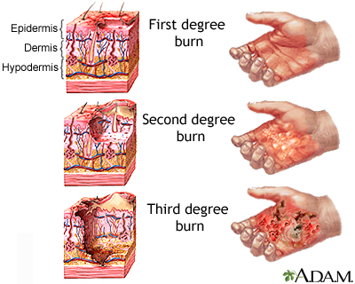
Degree burn

Slide 19
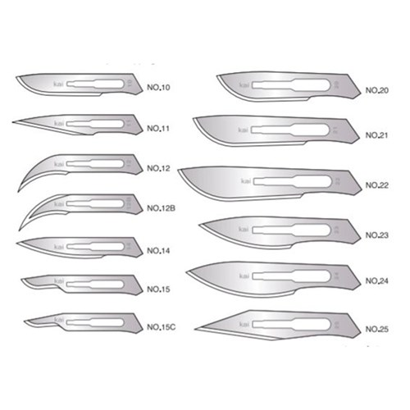
BLADES & HANDLE

Slide 21
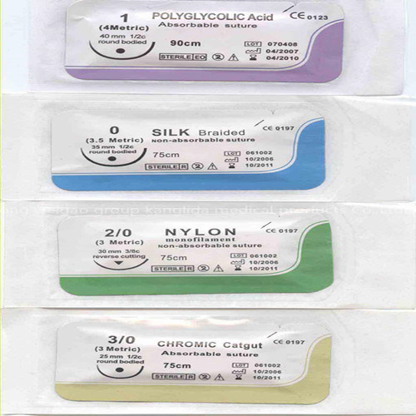
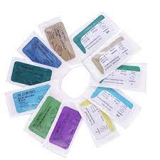

Slide 22
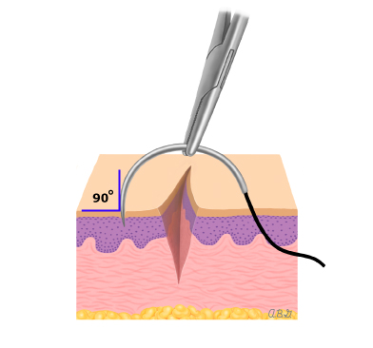
TYPES OF SUTURES

Slide 23
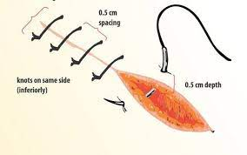
SUTURING TECHNIQES

Slide 25
SUTURE MATERIALS

Slide 26
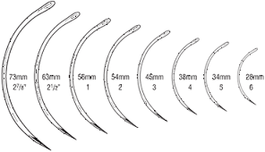
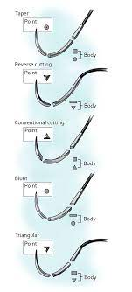
NEEDLES

Slide 27
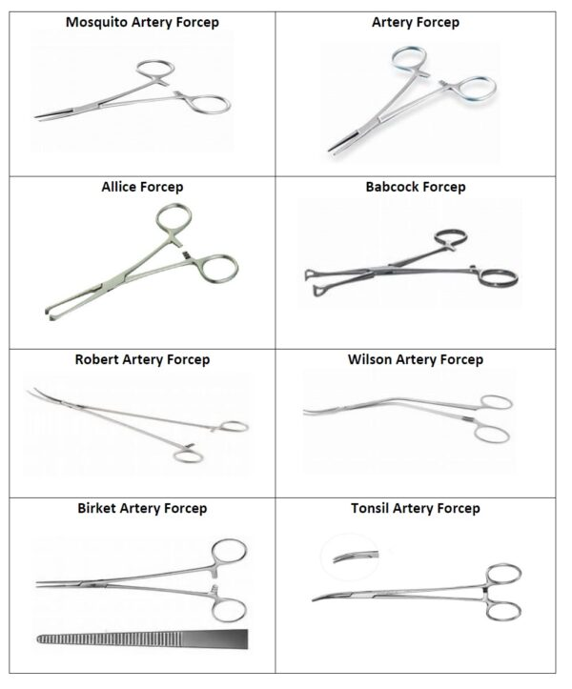

Slide 29
Type of anesthesia
General Anesthesia
Regional Anesthesia; This type of anesthesia, including spinal blocks and epidurals
Local Anesthesia

Slide 30
side effects and complications
Nausea and vomiting Chills and shivering (hypothermia)
Muscle aches Sore throat
Postoperative delirium Itching
Postoperative delirium or cognitive dysfunction
Malignant hyperthermia

Slide 31
risks of anesthesia
Most side effects are minor and temporary, such as nausea, vomiting, chills, confusion for a few days, and a sore throat caused by a breathing tube.

Slide 32
Based on duration of action
Ultra short
short
medium
long
Pulpal= <10 min
Soft tissue= 30-45 min
-Clorprocaine
-Procaine
Pulpal= 5-10 min
Soft tissue= 60-120 min
-lidocaine
-Prilocaine
Pulpal= 45-90 min
Soft tissue= 120-240 min
Mepivacaine
Artricaine
Pupal= 90-180 min
Soft tissue= 240-540 min
Bupivacaine
Etidocaine

Slide 33
Based on potency
low
intermediate
high
-Procaine
-Chlorprocaine
-Lidocaine
-Mepivacaine
-Tetracaine
-Bupivacaine
-Dibucaine

Slide 34
Timeline
Sep
oct
nov
dec
jan
Synergize scalable
e-commerce
Disseminate standardized
metrics
Coordinate
e-business applications
Foster holistically superior methodologies
Deploy strategic networks with compelling
e-business needs

Slide 35
Areas of focus
B2B market scenarios
Cloud-based opportunities
Develop winning strategies to keep ahead of the competition
Capitalize on low hanging fruit to identify a ballpark value
Visualize customer directed convergence
Iterative approaches to corporate strategy
Establish a management framework from the inside

Slide 36
How we got there
ROI
Envision multimedia-based expertise and cross-media growth strategies Visualize quality intellectual capital Engage worldwide methodologies with web-enabled technologies
Niche markets
Pursue scalable customer service through sustainable strategies Engage top-line web services with cutting-edge deliverables
Supply chains
Cultivate one-to-one customer service with robust ideas Maximize timely deliverables for real-time schemas

Slide 37
Summary
At Contoso, we believe in giving 110%. By using our next-generation data architecture, we help organizations virtually manage agile workflows. We thrive because of our market knowledge and great team behind our product. As our CEO says, "Efficiencies will come from proactively transforming how we do business."

Slide 38
Thank you
Mirjam Nilsson​
mirjam@contoso.com | www.contoso.com

