Slide 1
Family-Centered Care the Child during Hospitalization
Asst. Prof. Dr.Tassanee Attharos

Slide 2
Child’s voice
They looked at my throat and they looked at my ears. They looked at my heart but they didn’t looked at me.
เธอตรวจคอและตรวจหูของฉัน ฟังเสียงหัวใจของฉัน แต่ไม่ได้เข้าใจจิตใจฉันเลย

Slide 3
Stressors and Reactions of the Child during Hospitalization
1. Separation Anxiety
2. Lose of control
3. Pain and Body injury

Slide 4
Separation Anxiety
Manifestation of Separation Anxiety
1. Protest
2. Despair
3. Detachment

Slide 5
Phase of Protest
* cries
* screams
* searches for parent with eyes

Slide 6
Phase of despair
Inactive
Withdraws from orthers
Depressed, sad
Uninterested in environment

Slide 7
Phase of Detachment
- shows increased in interest in surroundings
-form new but superficial relationships

Slide 8
Loss of Control
Infant - inconsistency care lead to mistrust
Toddlers –loss of control results from altered routines and ritual
Preschoolers - loss of control caused by physical restriction
School-Age Child –routines in hospital activities usurp power and identity
Adolescents – react to dependency with rejections and uncooperativeness

Slide 9
Nursing Care the Child who is Hospitalized and the Family
Prevent and Minimizing Separation Anxiety
- Rooming – in
- Open visiting
- Psychological Support
- Family Education
- Maintain Child and Family Relationship

Slide 10
2. Minimizing Loss of Control
Promoting Freedom of Movement
Maintaining Child’s Routine
Encouraging Independence

Slide 11
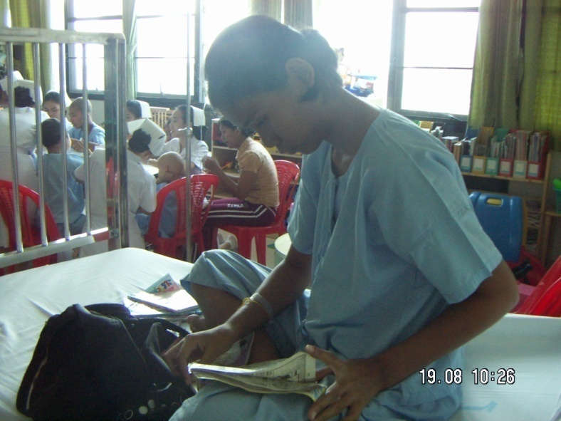
3. Providing Activities

Slide 12
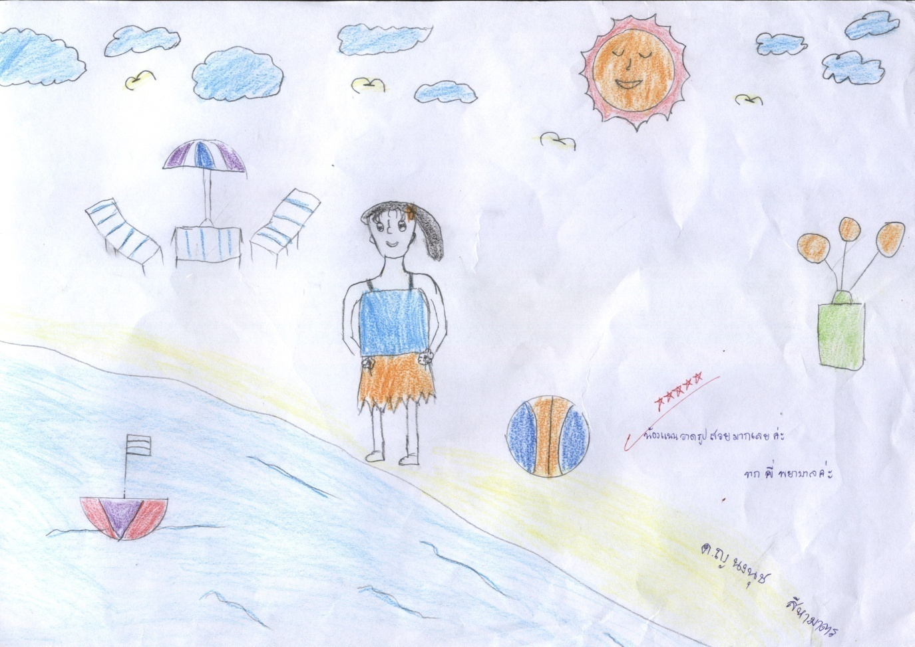
4. Using Play
- Recreation Play
- Therapeutic Play

Slide 13
5. Supporting Family’s Members
Providing Information

