Slide 1
Primary First Aid and Emergency
Supaluk PhuenTHOng

Slide 2
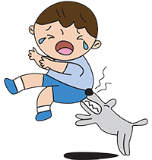
Lecture outline
Human & Animal bite, Toxic substance and Anaphylaxis
Bleeding, Shock and Choking
Fractures

Slide 3
Objective Learning
Understanding and able to treat who receive
Human & Animal bite, Toxic substance and Anaphylaxis
Bleeding, Shock and Choking
Fractures

Slide 4
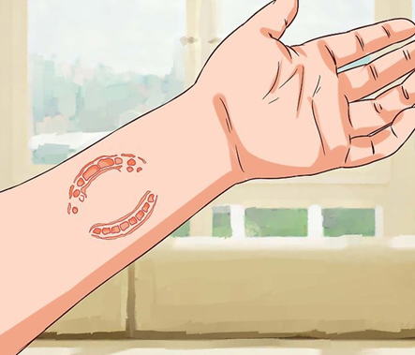
Human bite
Human bites can occur directly or indirectly. Biting among young children is the most common type of bite. But you can also get an indirect injury if your fist makes contact with another person’s mouth. Although most human bites aren’t serious, you should have any bite that breaks the surface of your skin looked at due to the risk of infection.

Slide 5
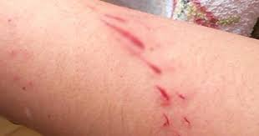
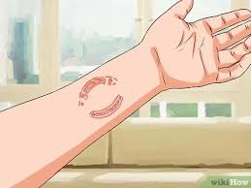
What are the symptoms of a human bite?
You’ll likely experience symptoms at the site of your injury, including:
Pain.
Tenderness.
Bleeding.
Swelling.
If an infection develops in the bite wound, you may have:
Intense pain and swelling.
Pus around your wound.
Redness around your wound.
Skin that feels warm to the touch.
Fever, chills or a general sense of feeling unwell.
A bite on your finger can sometimes damage tendons and/or nerves. Signs include:
Loss of feeling in your fingertip.
Trouble bending or fully straightening your finger

Slide 6
What are the symptoms of a human bite?
A bite on your finger can sometimes damage tendons and/or nerves. Signs include:
Loss of feeling in your fingertip.
Trouble bending or fully straightening your finger

Slide 7
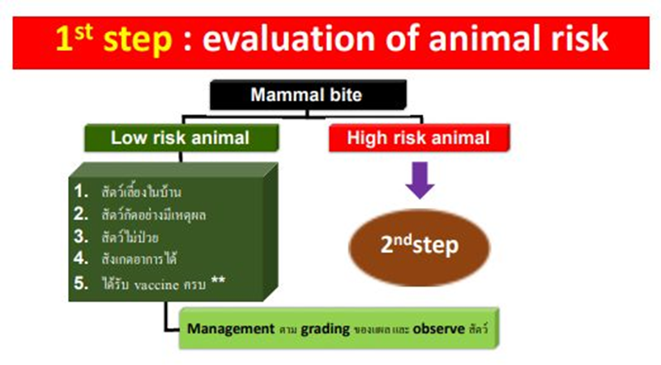
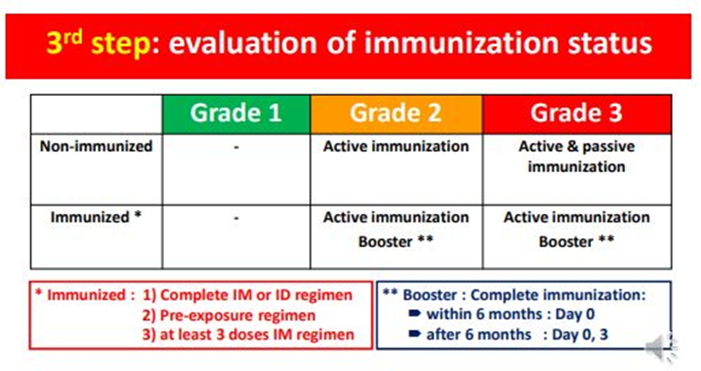
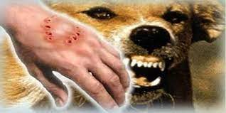
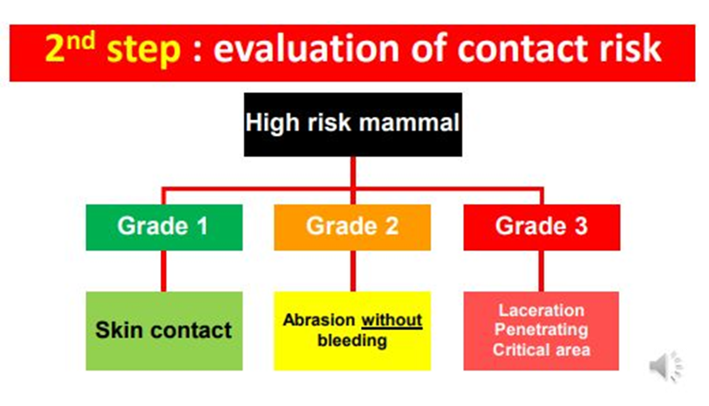
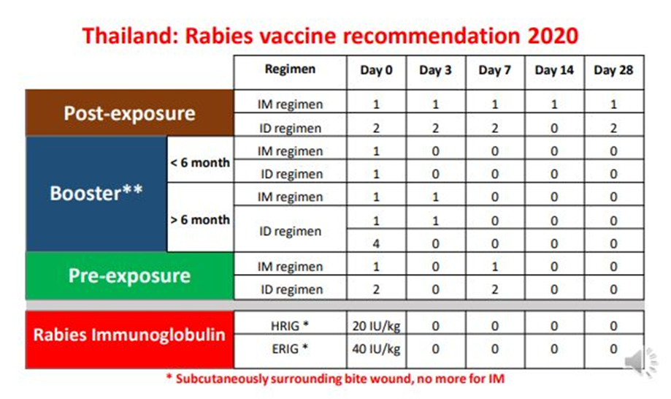
Animal bite
By Assits Prof. Dr. Jatuporn Sirikul

Slide 8
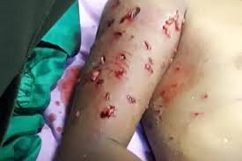
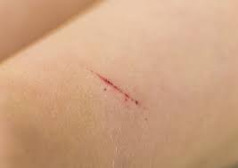
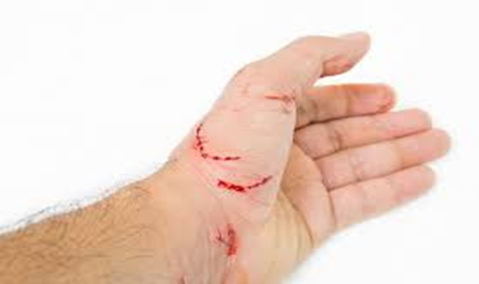
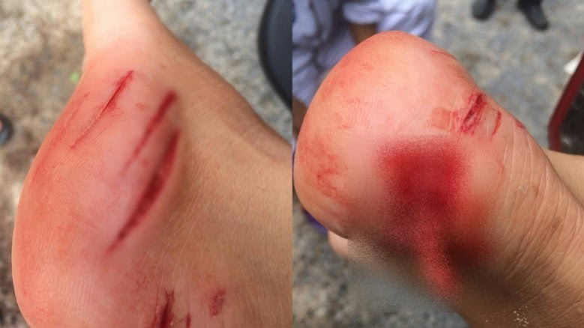
Animal bite
Animal bites pose a major public health problem in children and adults worldwide. The health impacts of animal bites are dependent on the type and health of the animal species, the size and health of the bitten person, and accessibility to appropriate health care.
Numerous animal species have the potential to bite humans; however the most important are those arising from snakes, dogs, cats and monkeys.

Slide 9
Snake bite

Slide 10
Snake bite
Treatment
Approximately 600 species of snake are venomous and approximately 50-70% of bites by these cause envenomation. At the time of a bite, the cornerstone of care is complete immobilization of the affected body part and prompt transfer to a medical facility. Tourniquets and cutting wounds can worsen the effects of the venom and should not be used as first aid.
Frequently, victims of snake bites will require treatment with antivenom. It is important that the antivenom is appropriate for snakes endemic to the region. Additional measures include wound cleansing to decrease infection risk, supportive therapy such as airway support, and administration of tetanus vaccine upon discharge if the person has been inadequately vaccinated against tetanus.

Slide 11
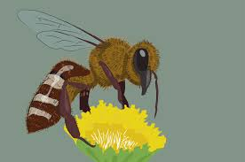
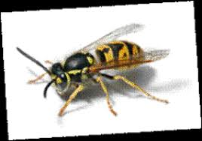
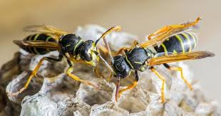
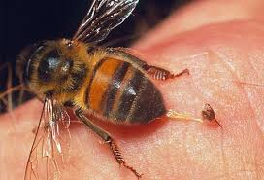
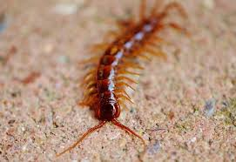
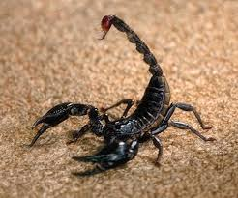
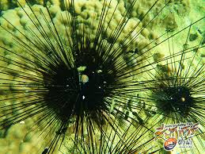
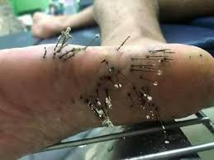
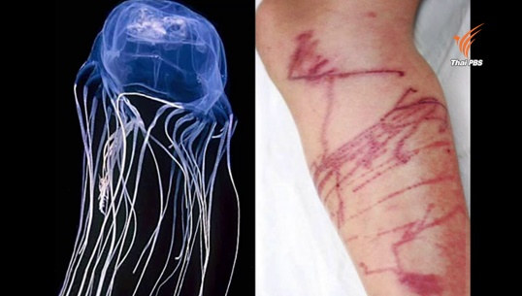
Bee / Wasp / Hornet Sting
Scorpion sting / Centipede / Spider bite
Sea urchins
Jellyfish dermatitis

Slide 12
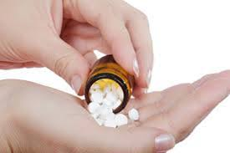
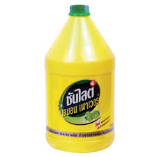
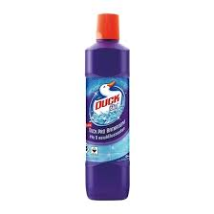
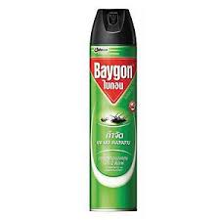
Toxic substance / Drug over dose
A toxic substance is a substance that can be poisonous or cause health effects. People are generally concerned about chemicals like polychlorinated biphenyls (PCBs) and dioxin which can be found at some hazardous waste sites. Products that we use daily, such as household cleaners, prescription and over-the-counter drugs, gasoline, alcohol, pesticides, fuel oil and cosmetics, can also be toxic. Any chemical can be toxic or harmful under certain conditions.

Slide 13
Toxic substance / Drug over dose
Drug overdoses can be accidental or intentional. They occur when a person takes more than the medically recommended dose. However, some people may be more sensitive to certain medications, so the low (more dangerous) end of a drug may be toxic for them; a dose that is still within the range of acceptable medical use may be too much for their bodies to handle.
Illicit drugs, used to get high, may be taken in overdose amounts when a person's metabolism cannot detoxify the drug fast enough to avoid unintended side effects.
Exposure to chemicals, plants, and other toxic substances that can cause harm are called poisonings. The higher the dose or the longer the exposure, the worse the poisoning. Two examples are carbon monoxide poisoning and mushroom poisoning.
People respond differently to a drug overdose. Treatment is tailored to the individual's needs.
Drug overdoses can involve people of any age. It is most common in very young children (from crawling age to about age 5) and among teenagers to those in their mid-30s.

Slide 14
Anaphylaxis
Drug overdoses can be accidental or intentional. They occur when a person takes more than the medically recommended dose. However, some people may be more sensitive to certain medications, so the low (more dangerous) end of a drug may be toxic for them; a dose that is still within the range of acceptable medical use may be too much for their bodies to handle.
Illicit drugs, used to get high, may be taken in overdose amounts when a person's metabolism cannot detoxify the drug fast enough to avoid unintended side effects.
Exposure to chemicals, plants, and other toxic substances that can cause harm are called poisonings. The higher the dose or the longer the exposure, the worse the poisoning. Two examples are carbon monoxide poisoning and mushroom poisoning.
People respond differently to a drug overdose. Treatment is tailored to the individual's needs.
Drug overdoses can involve people of any age. It is most common in very young children (from crawling age to about age 5) and among teenagers to those in their mid-30s.

Slide 15
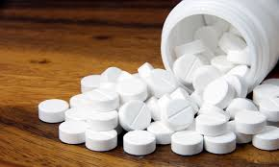
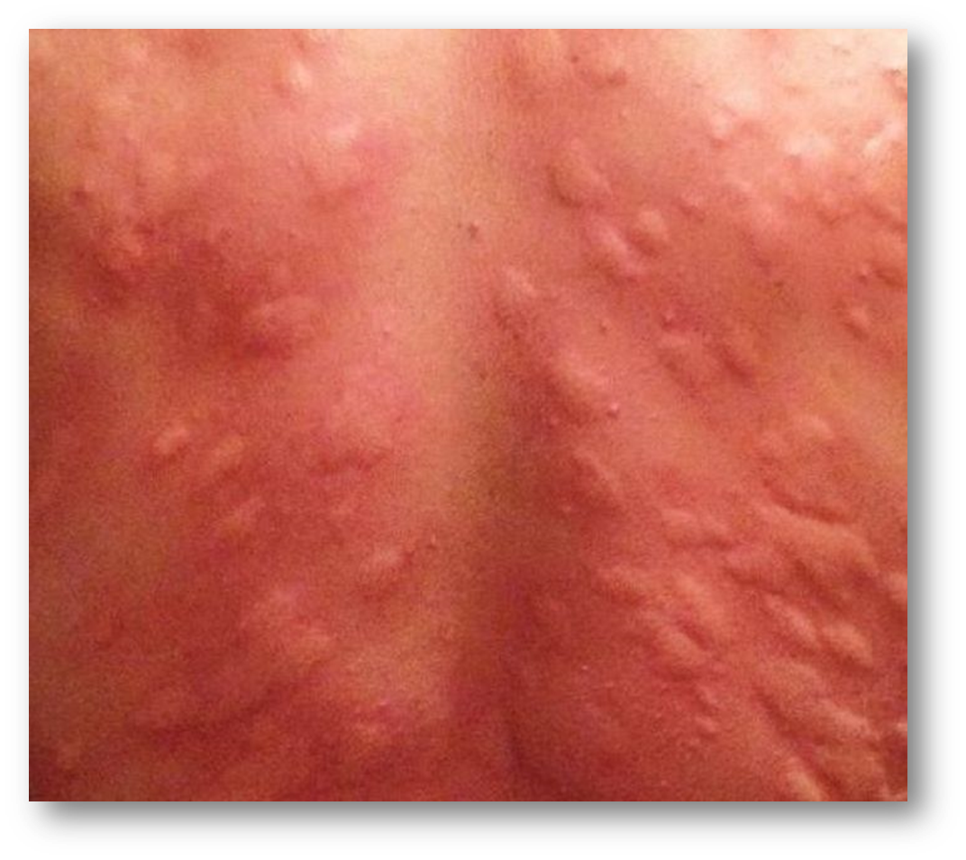
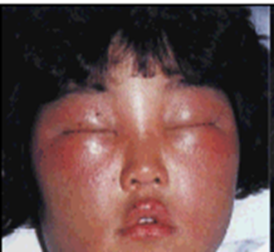
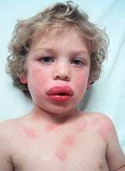
Treatment
During an anaphylactic attack, you might receive cardiopulmonary resuscitation (CPR) if you stop breathing or your heart stops beating. You might also be given medications, including:
Epinephrine (adrenaline) to reduce the body's allergic response
Oxygen, to help you breathe
Intravenous (IV) antihistamines and cortisone to reduce inflammation of the air passages and improve breathing
A beta-agonist (such as albuterol) to relieve breathing symptoms

Slide 16
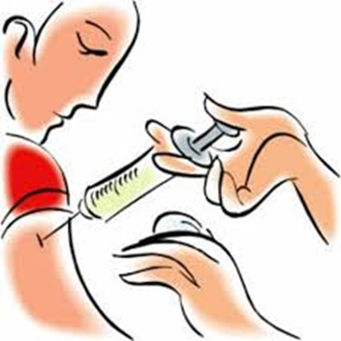
What is difference between serum and vaccine?
Vaccines stimulate the body to produce its own immunity to a specific disease, but serum therapy takes disease-fighting chemicals (antibodies) from the blood of recovered patients and transfers them to the sick to boost their defenses.

Slide 17
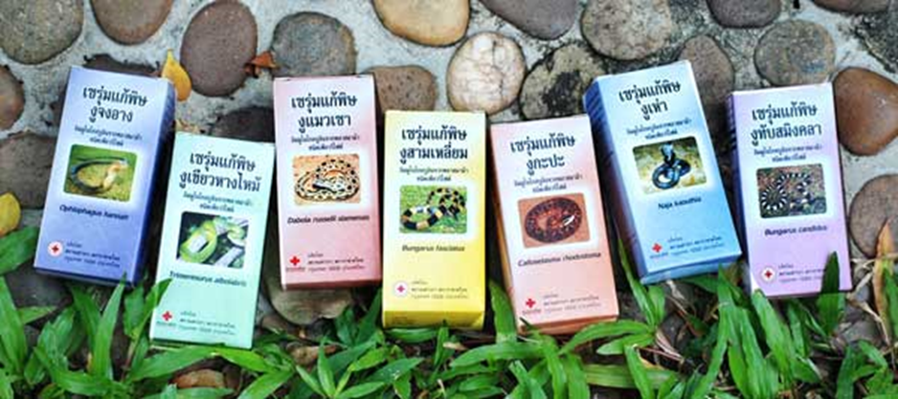
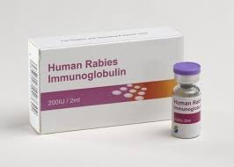
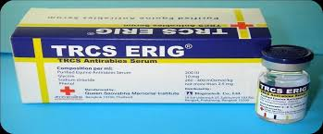
Serum

Slide 18
killed vaccine
One alternative to attenuated vaccines is a killed or inactivated vaccine. Vaccines of this type are created by inactivating a pathogen, typically using heat or chemicals such as formaldehyde or formalin. This destroys the pathogen’s ability to replicate, but keeps it “intact” so that the immune system can still recognize it. (“Inactivated” is generally used rather than “killed” to refer to viral vaccines of this type, as viruses are generally not considered alive.) Because killed or inactivated pathogens can’t replicate at all, they can’t revert to a more virulent form capable of causing disease (as discussed above with live, attenuated vaccines). However, they tend to provide shorter protection than live vaccines, and are more likely to require boosters to create long-term immunity. Killed or inactivated vaccines on the U.S. Recommended Childhood Immunization Schedule include the inactivated polio vaccine and the seasonal influenza vaccine (injectable).

Slide 19
live attenuated vaccine
Attenuated vaccines can be made in several ways. Some of the most common methods involve passing the disease-causing virus through a series of cell cultures or animal embryos (typically chick embryos). Using chick embryos as an example, the virus is grown in different embryos in a series. With each passage, the virus becomes better at replicating in chick cells, but loses its ability to replicate in human cells. A virus targeted for use in a vaccine can be grown through—“passaged” through—upwards of 200 different embryos or cell cultures. Eventually, the attenuated virus will not replicate well (or at all) in human cells, and can be used in a vaccine. All the methods that involve passing a virus through a non-human host produce a version of the virus that can still be recognized by the human immune system, but cannot replicate well in a human host.

Slide 20
live attenuated vaccine
When the resulting vaccine virus is given to a human, it will not replicate enough to cause illness, but will still provoke an immune response that can protect against future infection. One concern that must be considered is the potential for the vaccine virus to revert to a form capable of causing disease. Mutations that can occur when the vaccine virus replicates in the body may lead to a more virulent strain. This is unlikely, as the vaccine virus’s ability to replicate is limited. However, possible mutations are considered when developing an attenuated vaccine. It is worth noting that mutations are somewhat common with the oral polio vaccine (OPV), a live vaccine that is ingested instead of injected. The vaccine virus can mutate into a virulent form and lead to rare cases of paralytic polio. For this reason, OPV is no longer used in the United States, and has been replaced on the Recommended Childhood Immunization Schedule by the inactivated polio vaccine (IPV). Protection from a live, attenuated vaccine typically outlasts the protection provided by a killed or inactivated vaccine.

Slide 21
Bleeding, Shock and Choking

Slide 22
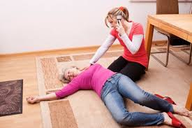
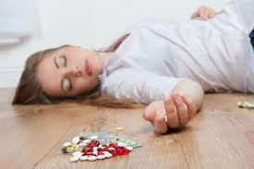
Bleeding
Bleeding is the loss of blood. It can be external, or outside the body, like when you get a cut or wound. It can also be internal, or inside the body, like when you have an injury to an internal organ. Some bleeding, such as gastrointestinal bleeding, coughing up blood, or vaginal bleeding, can be a symptom of a disease.
Shock
Shock is a life-threatening condition that occurs when the body is not getting enough blood flow. Lack of blood flow means the cells and organs do not get enough oxygen and nutrients to function properly. Many organs can be damaged as a result. Shock requires immediate treatment and can get worse very rapidly. As many 1 in 5 people in shock will die from it.
Choking
Choking happens when an object lodges in the throat or windpipe blocking the flow of air. In adults, a piece of food is usually to blame. Young children often choke on small objects. Choking is life-threatening. It cuts off oxygen to the brain.

Slide 23
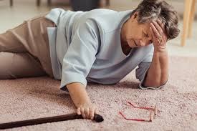
Syncope (pronounced “sin-ko-pea”) is the medical term for fainting or passing out. It happens when you have a sudden, temporary drop in the amount of blood that flows to your brain. Most of the time, a harmless, short-term cause makes you faint.
Syncope can happen if you have:
A sudden drop in blood pressure.
A drop in your heart rate.
Changes in the amount of blood in areas of your body.
If you pass out, you’ll likely become conscious and alert after a few seconds or minutes. However, you may feel confused or tired for a bit. You can recover fully in minutes or hours.
Syncope can be a sign of a more serious condition. It’s important to get treatment right away after you have an episode of syncope. Most people can prevent problems with syncope once they get an accurate diagnosis and proper treatment.
Syncope

Slide 24
Syncope

Slide 25
Unconsciousness
Unconsciousness is when a person is unable to respond to people and activities. Doctors often call this a coma or being in a comatose state.
Other changes in awareness can occur without becoming unconscious. These are called altered mental status or changed mental status. They include sudden confusion, disorientation, or stupor.
Unconsciousness or any other sudden change in mental status must be treated as a medical emergency.
Causes
Unconsciousness can be caused by nearly any major illness or injury. It can also be caused by substance (drug) and alcohol use. Choking on an object can result in unconsciousness as well.
Brief unconsciousness (or fainting) is often a result from dehydration, low blood sugar, or temporary low blood pressure. It can also be caused by serious heart or nervous system problems. A doctor will determine if the affected person needs tests.
Other causes of fainting include straining during a bowel movement (vasovagal syncope), coughing very hard, or breathing very fast (hyperventilating).

Slide 26
Unconsciousness

Slide 27
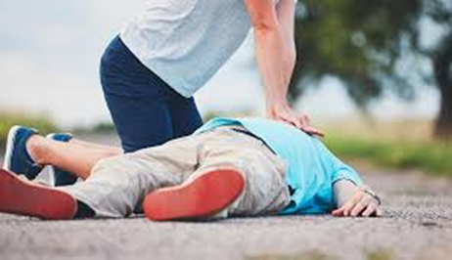
Cardiopulmonary arrest
Cardiopulmonary arrest (CPA) is the cessation of effective ventilation and circulation. It is also known as cardiac arrest or circulatory arrest. In adults, it is most likely to be caused by a primary cardiac event. The most common electrical mechanism which is responsible for 50 to 80% of cardiopulmonary arrest is ventricular fibrillation (VF). While, 20% to 30% which represents the less common causes of dysrhythmias involve Pulseless electrical activity (PEA), and asystole. Pulseless sustained ventricular tachycardia (VT) is a less common mechanism. This condition could progress to sudden death if it not treated promptly. Nevertheless, a cardiopulmonary arrest (CPA) could be reversed by cardiopulmonary resuscitation and/or cardioversion or defibrillation, or cardiac pacing.

Slide 28
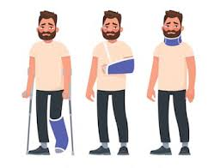
Fractures

Slide 29
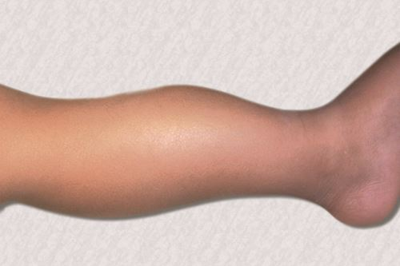
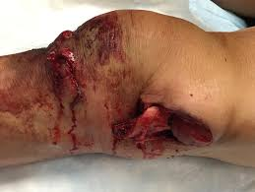
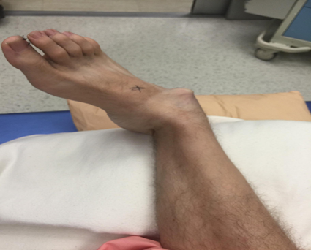
A bone fracture
A bone fracture is a crack or break in a bone. Bone fractures usually result from a high force impact or stress. But, people with osteoporosis or bone cancer may experience a fracture with very little impact.
A fracture that results from a medical condition that weakens the bones is called a pathological fracture.

Slide 30
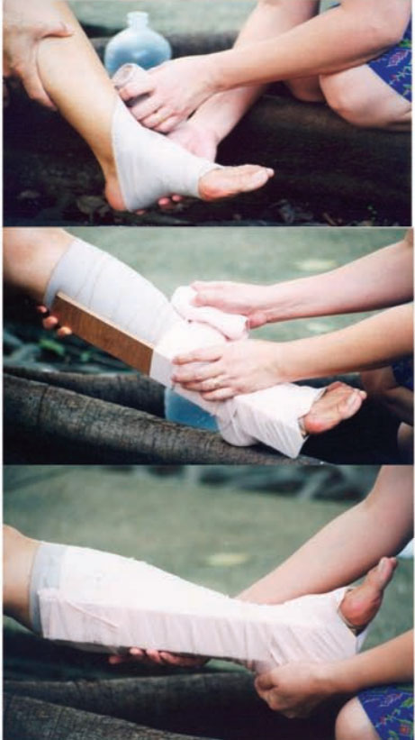
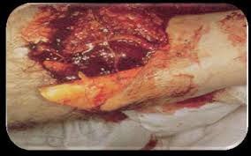
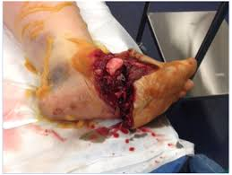
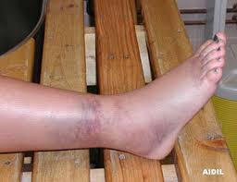
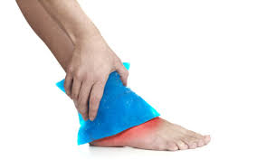
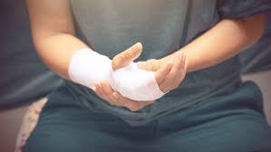

Slide 31
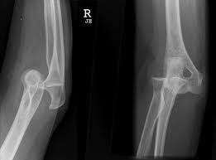
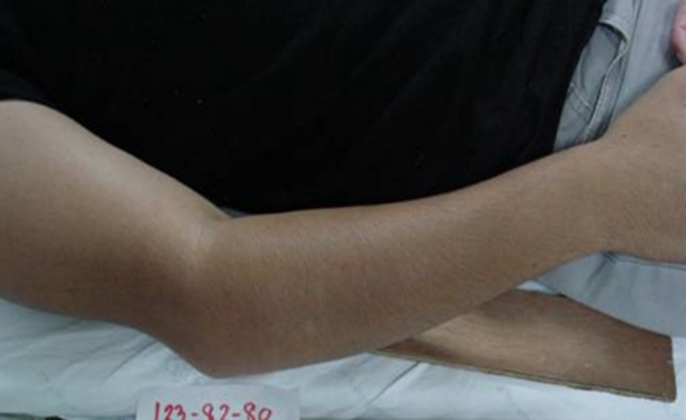
Dislocated
A dislocation is the medical term for bones in one of your joints being pushed out of their usual place. They can affect any joint in your body. Dislocations almost always happen during traumas or sports injuries. Never try to push or force a dislocated joint back into place on your own.

