Slide 1
CANCER PATIENTS AT THE END OF LIFE IN PALLIATIVE CARE Dr.Nopbhornphetchara Maungtoug RN.,MSN.,PhD.

Slide 2
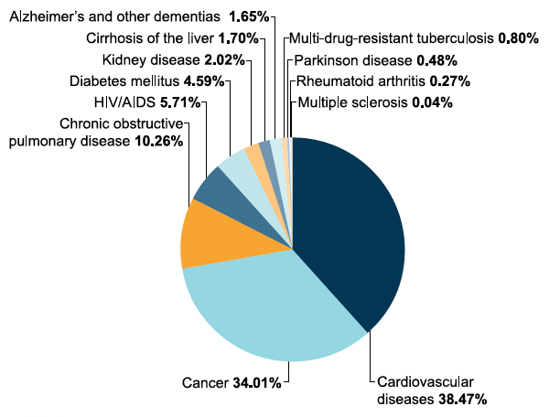
Background and the significance of the issue
Sources: World Health Organization and Worldwide Palliative Care Alliance: Global Atlas of Palliative Care at the End of Life,2014
Notes:
Worldwide, cancer challenges patients, families, caregivers and societies.
It is a leading cause of death and the number of new cases
is expected to increase by approximately 70% over the next two decades (World Health Organization, 2015).
Cancer is the second leading cause of death globally, and is responsible for an estimated 9.6 million deaths in 2018. Globally, about 1 in 6 deaths is due to cancer.
Approximately 70% of deaths from cancer occur in low- and middle-income countries.
In Thailand, the number of patients with cancer is increasing every year (National Cancer Institute, 2014), and cancer remains the leading cause of death.
In 2015, the cancer mortality rate in Thailand was 112.8
patients per 100,000 population. Between 2011 and 2015, liver cancer, lung cancer and leukaemia were the cancer types with the highest mortality rates in Thailand

Slide 3
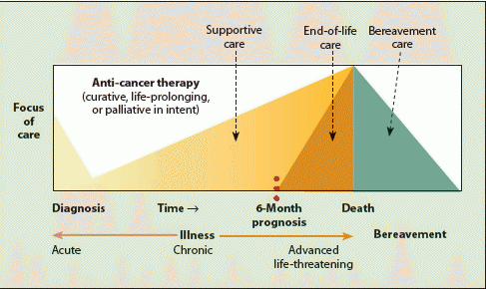
Model of palliative cancer care
Sources Model of palliative cancer care by Von Roenn & Temel (2011)

Slide 4
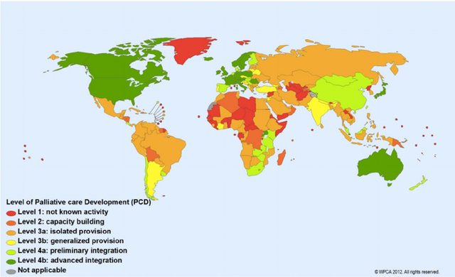
World map of palliative care development
Source: Lynch T, Connor S, Clark D. Mapping levels of palliative care development: a global update. J Pain Symptom Manage 2013; 45: 1094e2010.

Slide 5
THAILAND PALLIATIVE CARE POLICY 2017
Thailand Palliative Care Policy 2017 provide palliative care services, including through primary health care centers and homes
Establish quality end of life care networking with Ministry of interior, Ministry of Social Development and Civil Society
Establish seamless palliative care services by creating referral system from central hospital › provincial hospital › community hospital › sub-district hospital to home care team.
Human resource development, improve knowledge, skill for palliative care team
Set standard services, clinical practice guidelines.
Opioid supply can provide strong opioids and medication for symptom management in community level

Slide 6
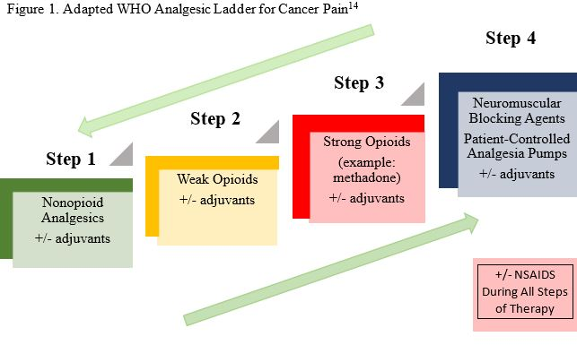
Pain Management

Slide 7
Thank you for your attention

