Slide 1
Nursing Professional Practice
Asst. Prof. Dr. Muntanavadee Maytapattana

Slide 2
Contents
1. Characteristics of a Good Nurse
2. Competency of Nursing
Professional
3. Evidence-Based Practice (EBP)
4. Trends of Nursing Practice
in many Countries
5. “Thai Nursing Quality VS Other Countries Nursing Quality”

Slide 3
https://youtu.be/C-mSFvxep38

Slide 4
Characteristics of a Good Nurse
Caring
An effective nurse is caring, understanding, nonjudgmental and has a strong ability to empathize with patients from all walks of life. Registered nurses deal with the sick and injured and their families on a daily basis, and they need to be able to show them that they truly care about their situations.

Slide 5
Characteristics of a Good Nurse
Communicative
Communication skills, it’s one of the most important aspects of the nurse career. Because, nurses have to be able to communicate with doctors, patients and coworkers in a very fast-paced environment. Good nurses are able to follow directions without a problem and easily communicate with patients and families. Effective communication skills in nursing create a high level of patient satisfaction.

Slide 6
Characteristics of a Good Nurse
Responsible
Good nurses know how to perform all of their responsibilities with the utmost accuracy and detail. They play a major role in assessing and treating patients’ medical conditions. When dealing with the health of another human being, there is little room for error, so nurses must responsibly carry out their duties at all times.

Slide 7
Characteristics of a Good Nurse
Observant
Understanding patients and individualizing their care is an exercise in observation as well as communication. An attention to detail will take you far in this field as a slight change in a patient’s vital signs, coloring or alertness can be indicative of something larger.

Slide 8
Characteristics of a Good Nurse
Team Player
Teamwork is essential for healthcare teams to have. Working with physicians, specialists, nurse assistants, patients and their families, nurses have to be good team players who facilitate communication and do whatever is necessary to aide in the execution of effective care.

Slide 9
Characteristics of a Good Nurse
Flexible
Overtime, overnight shifts and working in different departments are all examples of ways a nurse has to be flexible. A positive attitude regarding new experience and taking on the challenges of the day will go a long way and lead to valuable lessons along the way that can help shape your career.
Retrieved from https://www.jacksonvilleu.com/blog/nursing/qualities-of-a-good-nurse/

Slide 10
Retrieved from https://www.slideshare.net/LindaNazarko/march-2016-competency-development-for-advanced-nursing

Slide 11
Nursing Competency meaning
A core competency of nursing is “the ability to practice nursing that meets the needs of clients cared for using logical thinking and accurate nursing skills.”
The nursing competency structure consists of four abilities: the ability to understand needs, the ability to provide care, the ability to collaborate and the ability to support decision-making. These four abilities are closely related and utilized in all types of nursing practice settings. (Fukada, 2018)
https://www.ncbi.nlm.nih.gov/pmc/articles/PMC5871720/pdf/yam-61-001.pdf

Slide 12
Thailand Nursing and Midwifery Council
https://www.tnmc.or.th/
https://www.tnmc.or.th/news/15
https://www.tnmc.or.th/images/userfiles/files/A111.PDF
https://www.tnmc.or.th/images/userfiles/files/A222.PDF
https://www.tnmc.or.th/images/userfiles/files/A333.pdf
https://www.tnmc.or.th/images/userfiles/files/A444.pdf
https://www.tnmc.or.th/images/userfiles/files/A555.pdf

Slide 13
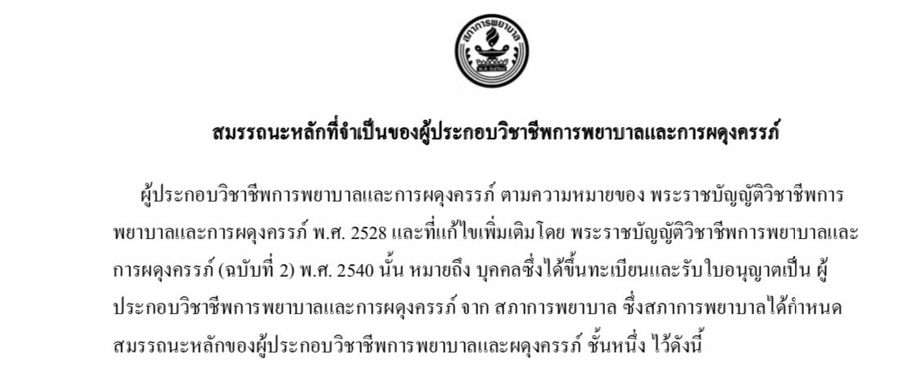
Competency of Nursing Professional
Retrieved from http://110.164.68.234/nurse_/files/ethics04.pdf

Slide 14
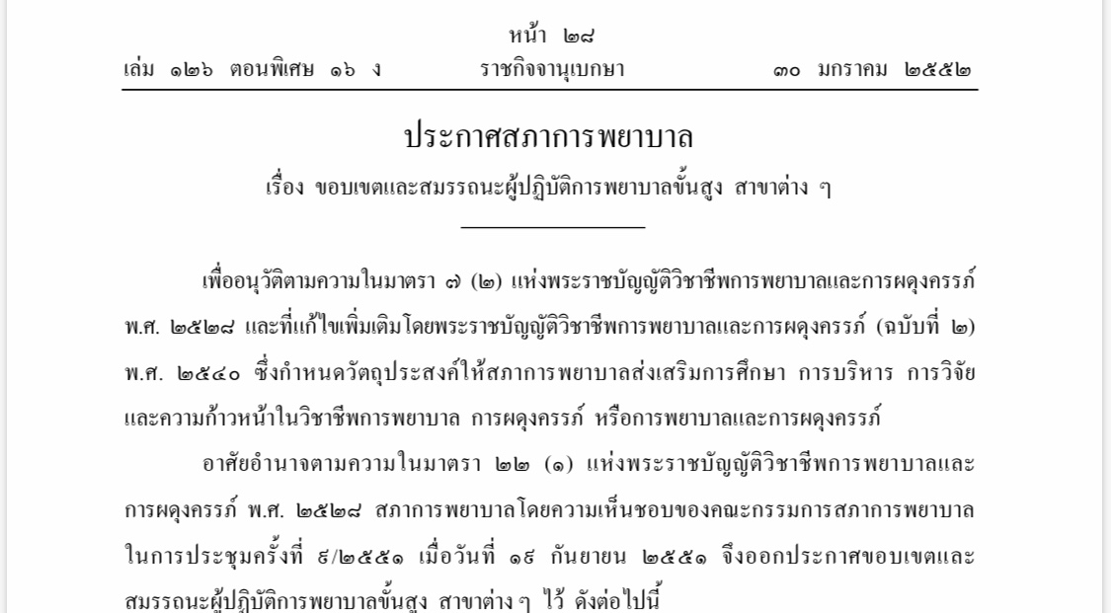
Retrieved from https://www.tnmc.or.th/images/userfiles/files/H014.pdf

Slide 15
Retrieved from https://www.tnmc.or.th/images/userfiles/files/004.pdf

Slide 16
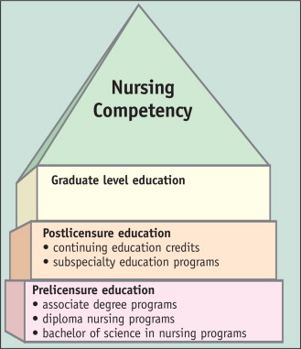
Retrieved from https://www.sciencedirect.com/science/article/abs/pii/S0001209208003256

Slide 18
Evidence-Based Practice
https://youtu.be/j5sU5H-IBSg

Slide 19
What is the Evidence-Based Practice?
EBP is a process used to review, analyze, and translate the latest scientific evidence. The goal is to quickly incorporate the best available research, along with clinical experience and patient preference, into clinical practice, so nurses can make informed patient-care decisions (Dang et al., 2022).
https://www.hopkinsmedicine.org/nursing/center-nursing-inquiry/nursing-inquiry/evidence-based-practice.html#:~:text=EBP%20is%20a%20process%20used,et%20al.%2C%202022)
.

Slide 20
Six steps in EBP process
https://libguides.umsl.edu/ebp/process

Slide 21
The Steps in the EBP Process
ASSESS the patient | 1. Start with the patient -- a clinical problem or question arises from the care of the patient
ASK the question | 2. Construct a well built clinical question derived from the case
ACQUIRE the evidence | 3. Select the appropriate resource(s) and conduct a search
APPRAISE the evidence | 4. Appraise that evidence for its validity (closeness to the truth) and applicability (usefulness in clinical practice)
APPLY: talk with the patient | 5. Return to the patient -- integrate that evidence with clinical expertise, patient preferences and apply it to practice
Self-evaluation | 6. Evaluate your performance with this patient Schardt, C. and Mayer, J. 2010

Slide 22
How do I get involved in EBP?
https://www.hopkinsmedicine.org/nursing/center-nursing-inquiry/nursing-inquiry/evidence-based-practice.html#:~:text=EBP%20is%20a%20process%20used,et%20al.%2C%202022)
.

Slide 23
Evidence-Based Practice: EBP
Clinical Nursing Practice Guideline: CNPG
Good Quality of Nursing

Slide 24
Best Practice
https://jbi.global/sites/default/files/2021-10/JBI-ES-2062-2%20Non-Sterile%20Gloves_%20Appropriate%20Use%20in%20Healthcare%20Settings.pdf

Slide 25
Clinical Nursing Practice Guideline: CNPG
http://med.swu.ac.th/msmc/w8-1/images/km/KM%2001.pdf

Slide 26
Clinical practice guidelines for diagnosis, treatment, and prevention of infection in hospitals: In case of corona virus infection (COVID-19)
https://covid19.dms.go.th/backend///Content//Content_File/Covid_Health/Attach/25660418150721PM_CPG_COVID-19_v.27_n_18042023.pdf

Slide 28
Trends of Nursing Practice

Slide 29
In Thailand
https://he02.tci-thaijo.org/index.php/nur-psu/article/view/100457/78129

Slide 31
In other Countries

Slide 32
In other Countries
Evidence-Based nursing practice
Community-Based nursing
Trans-cultural nursing
Disaster preparedness
Rising of nurse informatics
Increasing consumer sophistication
Specialization and education
Nursing shortages
Recruitment and Retention

Slide 34
Discussion Issue : “Thai Nursing Quality VS Other Countries Nursing Quality”
Assignment
Divided into 10 groups in class
Each group : search and review research papers/ VDO clips/ related to Nursing quality (EBP, Innovation, CPG etc.)
Draw slot to choose only 1 paper
Present in font of classroom (5 minutes)

Slide 35
ชื่อเรื่อง.................................................................(เอกสาร งานวิจัย คลิป หรือสิ่งประดิษฐ์)
ของหน่วยงาน..................ประเทศ......................................
รายชื่อกลุ่ม รหัสประจำตัว ทำหน้าที่ใดในกลุ่ม
1. ........................... …………………. ………………..
2. ........................... …………………. ………………..
3. ............................ …………………. …………………
สรุปสาระสำคัญจากเรื่อง
......................................................................................................................................................................................................................................................................................................................................................................
เอกสารอ้างอิง (เขียนแบบ APA)
..........................................................................................................................................................
เปรียบเทียบเรื่องนี้กับ (ถ้าเอกสารจากต่างประเทศทำข้อ 1/ ถ้าเอกสารของประเทศไทยทำข้อ 2)
1) การพยาบาลของประเทศไทยมีแบบนี้หรือไม่ บอกข้อได้เปรียบและข้อบกพร่อง ข้อเสนอแนะจากเรื่องที่ศึกษามา....................................................................................................................................................................................................................................................................................................................
2) การพยาบาลของประเทศอื่นมีแบบนี้หรือไม่ บอกข้อได้เปรียบและข้อบกพร่อง ข้อเสนอแนะจากเรื่องที่ศึกษามา..................................................................................................................................................................................................................................................................................................................

Slide 36
แบบประเมินการสัมมนาวิชา Issues and Professional Development (Issues & PD-2564)
การอภิปรายในชั้นเรียน เรื่อง..........................................................เกณฑ์การประเมิน 4 = ดีมาก, 3 = ดี, 2 = พอใช้, 1 = ปรับปรุง
หัวข้อการประเมิน | กลุ่ม1 | กลุ่ม2 | กลุ่ม3 | กลุ่ม4 | กลุ่ม5 | กลุ่ม6 | กลุ่ม7 | กลุ่ม8 | กลุ่ม9 | กลุ่ม 10
1. วิเคราะห์ประเด็นการสัมมนาได้กว้างขวางและลุ่มลึก (เต็ม 4 คะแนน)
2. สังเคราะห์ประเด็นและริเริ่มสร้างสรรค์สิ่งใหม่/เกิดความรู้ใหม่ๆ (เต็ม 4 คะแนน)
3. แสดงความคิดเห็นโดยอ้างอิงแหล่งข้อมูลที่น่าเชื่อถือ (เต็ม 4 คะแนน)
รวม 12 คะแนน = 10%

Slide 37
Examples
https://youtu.be/gJm_7cKo-A8
https://youtu.be/ZO99vpbTW-0

Slide 38
Questions?

Slide 39
Summary
1. Characteristics of a Good Nurse
2. Competency of Nursing
Professional
3. Evidence-Based Practice
4. Trends of Nursing Practice
in many Countries
5. “Thai Nursing Quality VS Other Countries Nursing Quality”

Slide 40
Thank you

