Slide 1
BNS 1
GEL 0105
English for Communication and Information Retrieval

Slide 2
Basic Conversation about FOOD
In this lesson, you can learn more how to talk about food. You’ll see how to talk about a basic conversation about food in your country. In this vocabulary lesson, you can also learn words and phrases to talk abut food and a phrasal verbs in English. And food partitives.

Slide 3
3 Questions you can ask about.

Slide 4
1. What is the food like in you country? Our food is ____________ ( spicy, sweet, etc.)
How do they make the food?
Our food is ________ ( grilled, fried, etc..)
What food is popular in your country?
We eat a lot of ________ ( spicy, fresh vegetables, etc.)
What food is popular in your country?
We eat a lot of ________ ( spicy, meat and fresh vegetables, etc.)

Slide 5
2. What is your country famous for?
Many people know _________
( papaya salad, Pad Thai, etc.)
It’s famous for _________
( spicy food, sticky rice with mango)

Slide 6
3. What is there to eat in your country?
People come to eat __________.
Pad Thai
Papaya salad
Sticky rice with mango

Slide 8
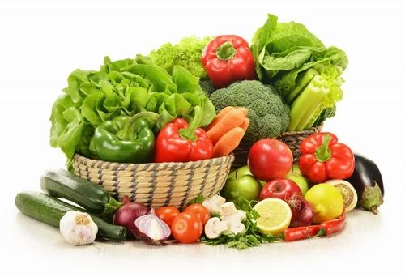
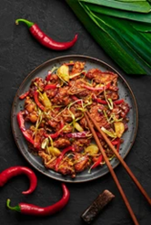
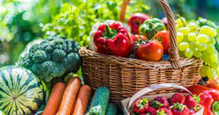
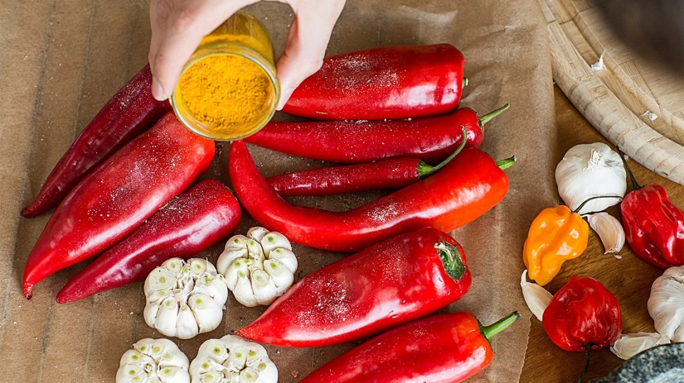
What is the food like in your country?
We eat a lot of fresh vegetables.
Our food mostly spicy.
We can’t eat with out spicy food.

Slide 9
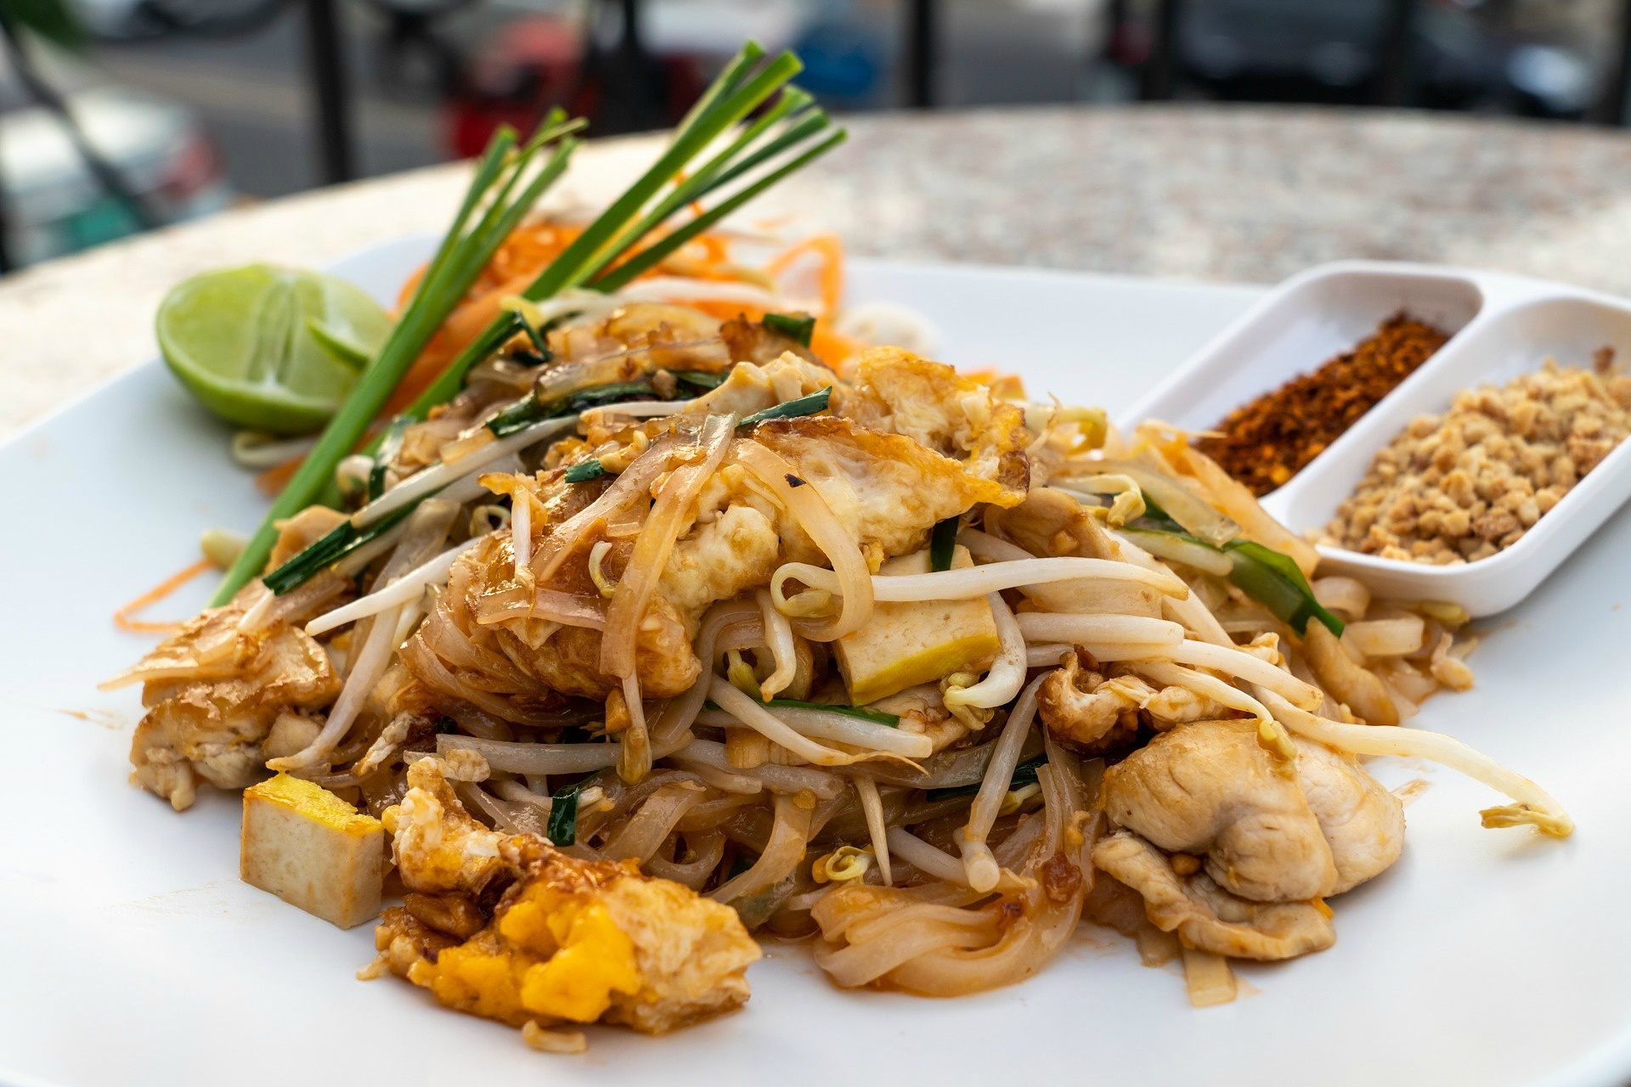
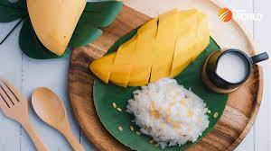
What is your country famous for?
It’s famous for spicy food.
Many people know about pad Thai.
It’s famous for sticky rice with mango.

Slide 10
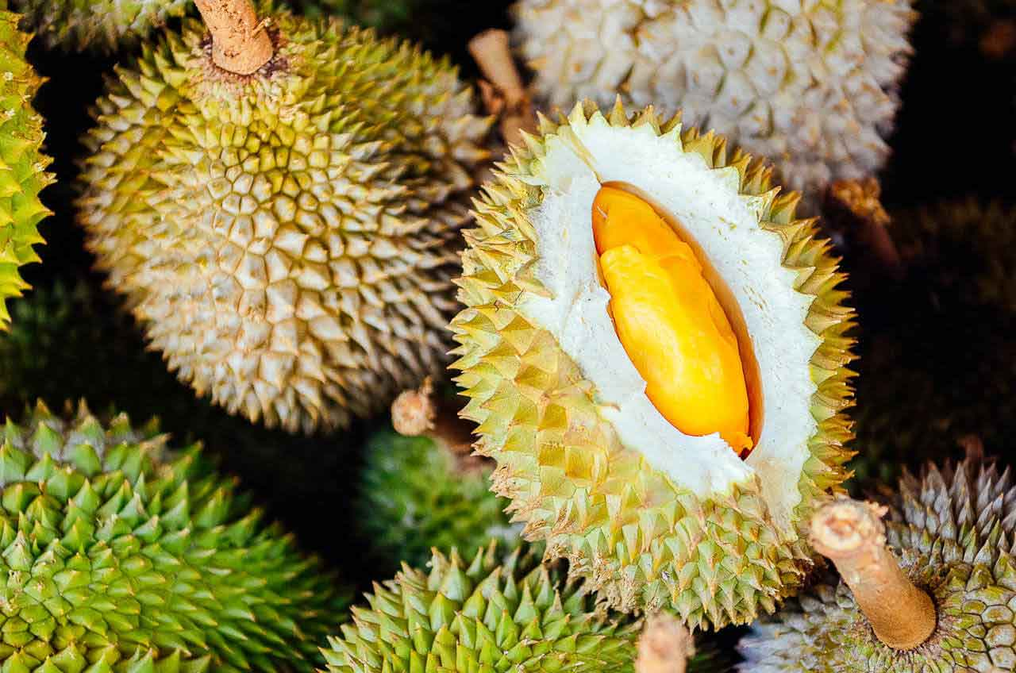
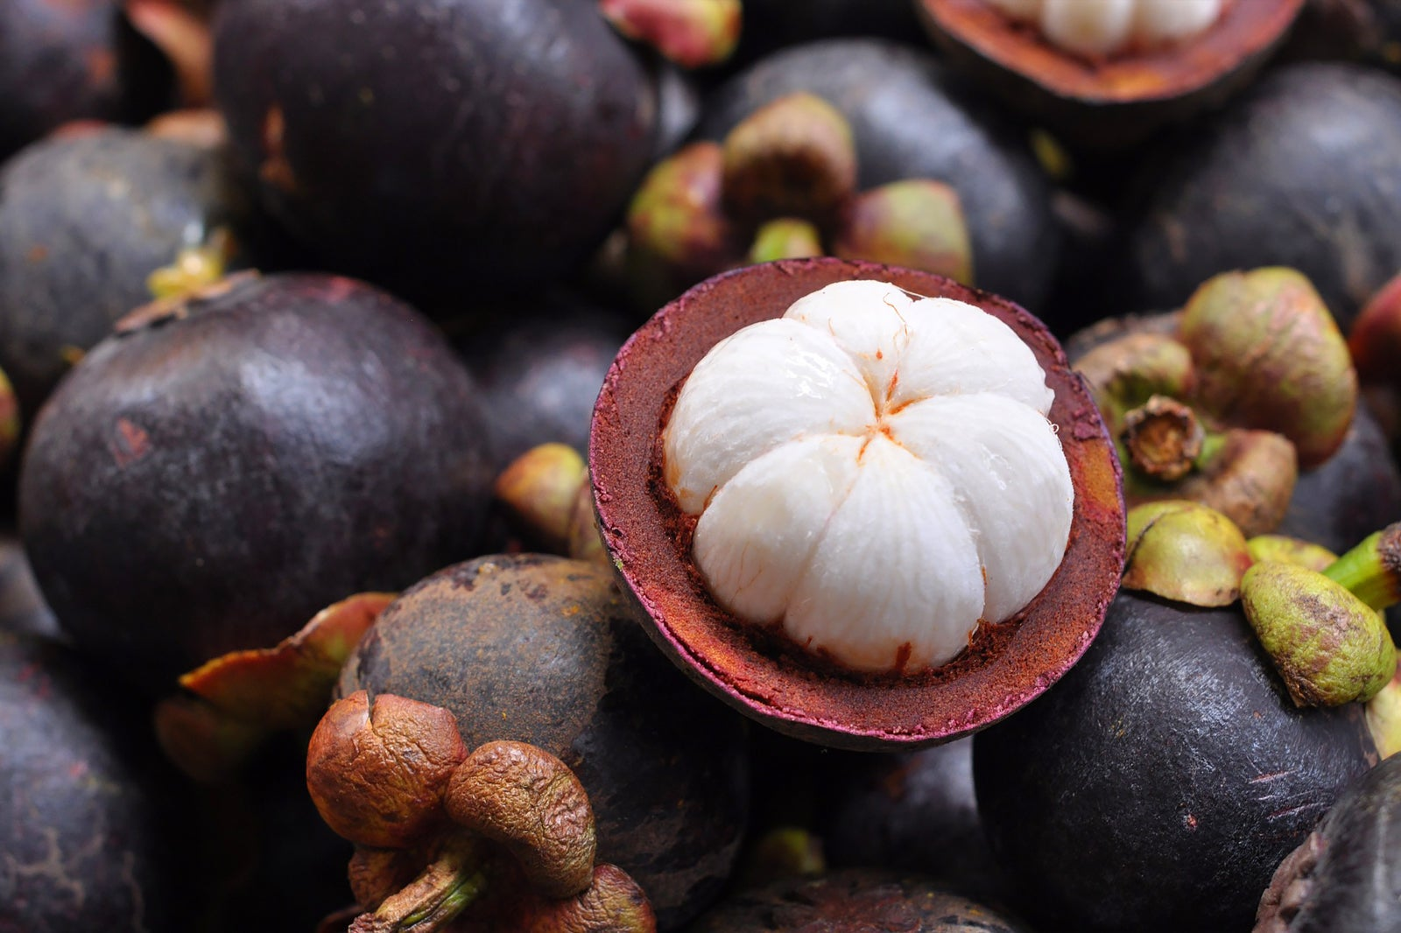
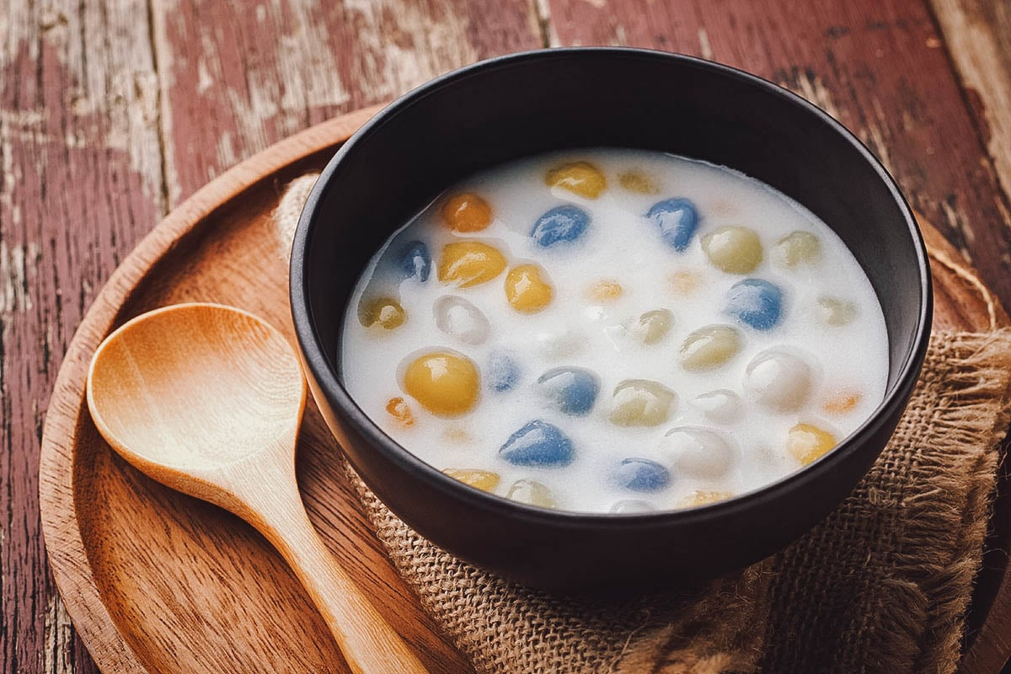
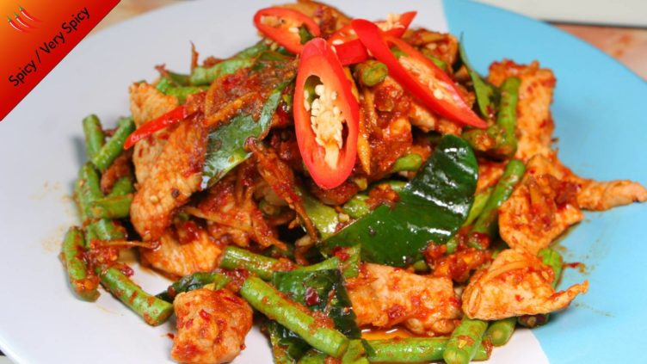
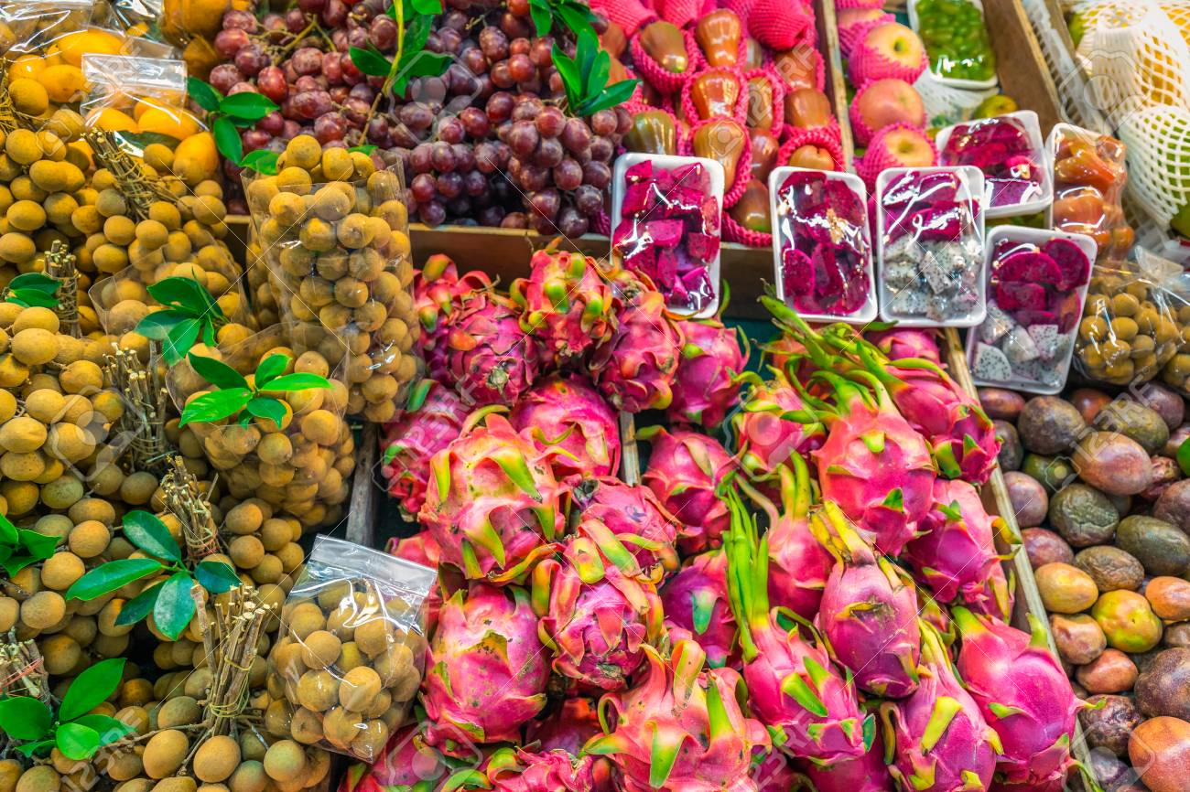
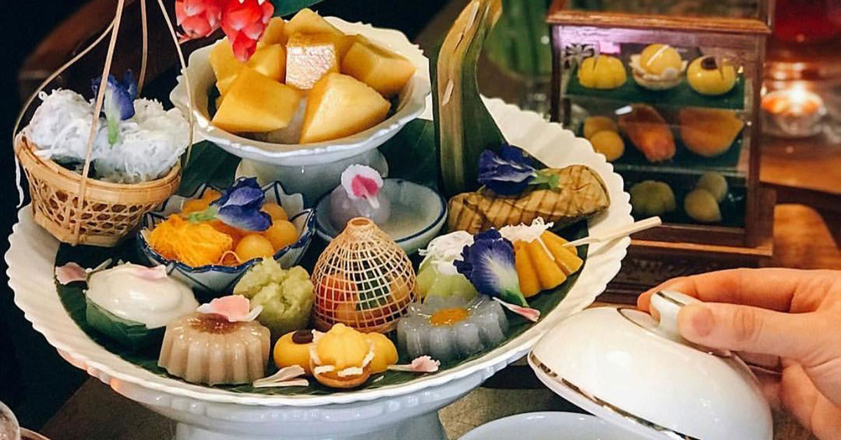
What is there to eat in your country?
People come to eat our different spicy food.
People come to eat our fresh fruit.
People come to eat our Thai desserts.

Slide 15
Example

Slide 16
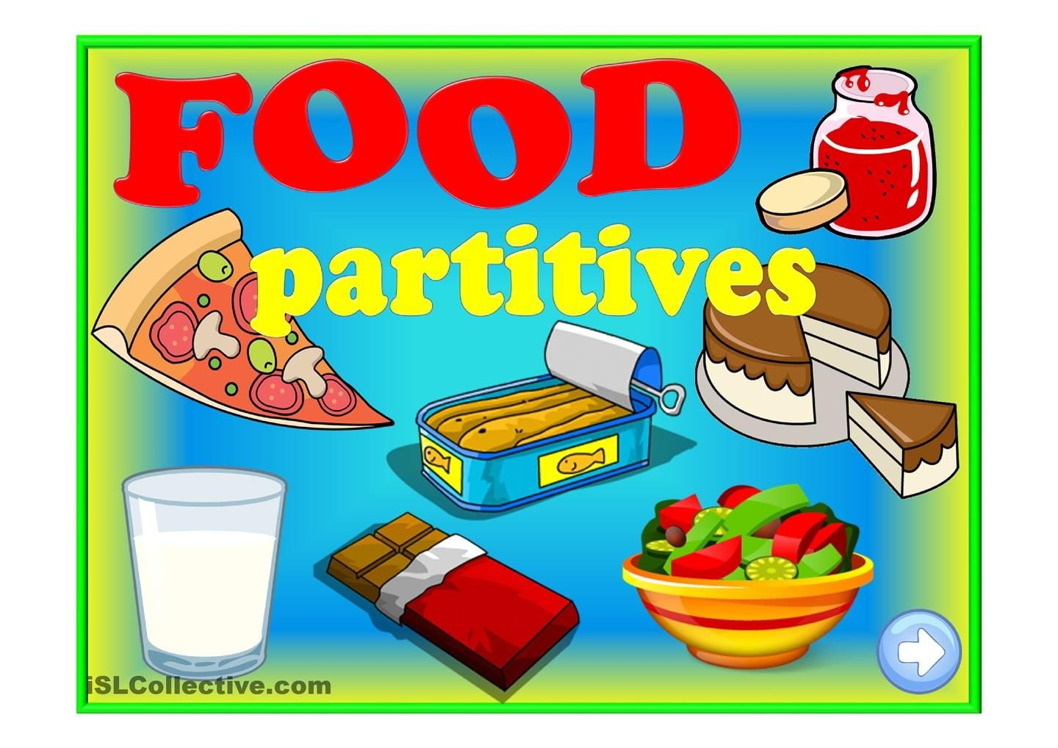

Slide 17
A partitive noun is a noun that is used to describe a part or quantity of something. Partitive nouns are used with another noun to tell you how much of that noun there is. "Boxes" in "three boxes of cereal" is a partitive noun because it describes a specific quantity of cereal.

Slide 21
Having family dinner

Slide 22
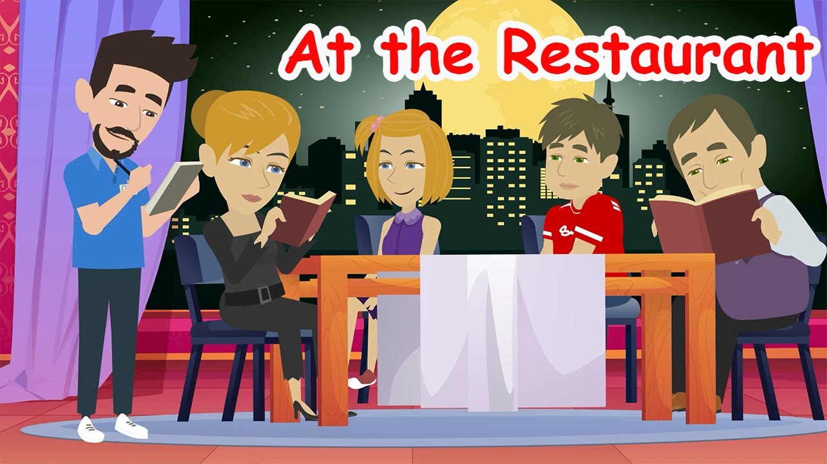

Slide 23
What do you want to eat?
The food is ready.
Be careful. It’s hot.
It looks yummy.
Have you ever had this one?
Try this one.
Can I have that one, please.
You should eat vegetable.
Eat slowly.
Do you want some more rice?
Can I have more of that, please.
Help me clear the table, please.
Wait a second.

Slide 29
https://www.youtube.com/watch?v=bgfdqVmVjfk

