Slide 2
What is a job?
a paid position of regular employment.
a job consists of duties, responsibilities, and tasks (performance elements) that are (1) defined and specific, and (2) can be accomplished, quantified, measured, and rated.

Slide 3
What is the difference between a job and a career?
A job can be just going to work to earn a paycheck.
A career means that each of your jobs, experiences, and training programs is helping you advance in pay or responsibility. ...
The real difference between a job and a career is your attitude. People who want a career are always thinking about their long-term goals.

Slide 4
Why job is important?
a job is an important factor and without work life is impossible. With job we can do everything, either fulfill our desires or family needs but the important one is we eventually attain confidence, self-respect & social status which makes us feel the part of society.

Slide 5
Target Vocabulary
Occupations
Places

Slide 6
More Vocabulary
Chef Fireman
Coach Judge
Teacher Police man
Musician Farmer
Nurse Pilot
Architect Doctor
Dentist Tailor
Builder Baker

Slide 22
Basic question and answer about job
Question | Answer
1. Who teaches the students? | The teacher teaches students.
2. Who works at the hospital? | The doctor works at the hospital.
3. Who looks after the patients? | The nurse look after patients.
4. Where does a police work? | The police work at the police station.
5. Does a nurse wear a uniform? | Yes, she does.

Slide 23
Advance question and answer about job
Question | Answer
1. What do you do? | I’m a teacher.
2. What does she do for a living? | She is teaching in the university.
3. Where do you work? | I work in an International school.
4. What do you have to do in your job? | I’m teaching English for Nursing.
5. What kind of company do you work for? | I work at Suan Sunandha Rajabhat University.

Slide 24
Part one: Introducing your job
I’m a ________
I work in ________
I work for ________
I am a teacher.
I work in the College of Nursing and health.
I work for nursing students.

Slide 25
More details example
I work in + field
I work in teaching students.
I work in medical field.
I work in + place/department
I work in the HR department of Bangkok Bank.
I work in the university teaching nursing students.
I work for + company
I am a teacher. I work for a government university.
I work for college of nursing and health based in SSRU.
I run my own business, so I work for myself.

Slide 26
Student Task 1: In your notebook
A- B-
I’m a ________ I work in + field
I work in _______ ____________________
I work for _______ I work in + place/department
_____________________
I work for + company
______________________

Slide 27
Part two: Describing your company
I work for a __________ company
which _____________________.
I work for a big public university which I am teaching nursing students.
I work for an international school which I am teaching modern English language.
Adjective
What does your company do?

Slide 28
What if you don’t work in a company
I’m a freelancer.
I’m self employed.
I’m a business owner.
If you don’t have a job
I’m between jobs at the moment.
I’m taking some time out to travel. Spend time with my family. Recover from an illness.
I’m retired.

Slide 29
Students Task 2: In your notebook
Complete the sentence:
What do you do?
I’m a nursing _________. I study in a ____________ government university at _________ ___________ ___________ ___________ under the ___________ of _________ and __________. With the degree of ___________ of ___________ ___________.
Adjective

Slide 30
Part three: How to describe your job in more details.
I have to _______
I’m responsible for _______
Most of my time is spent _______
I’m a nurse. I have to look after patients, give them medicine and make sure they’re comfortable. I’m responsible for about 20-30 patients. Most of my time is spent talking to patients and checking that everything is okay.
I’m a teacher. I have to teach students in school, I look after my students and make sure they learn and understand. I’m responsible for about 40-50 students. Most of my time is spent teaching students in the classroom and checking that everyone understand the lesson.

Slide 31
Students Task 3: In your notebook
I have to _______
I’m responsible for _______
Most of my time is spent _______

Slide 32
Part four: Saying how you feel about your job.
What is your job?
Where you work?
Do you like your job? Why or why not?

Slide 33
General Adjectives
Boring
Difficult
Positive Adjective | Negative Adjective
Stimulating | Exhausting
Satisfying | Thankless
Creative | Mind-numbing
Rewarding | Dead-end
Challenging | Soul-destroying

Slide 34
Students Task 4: In your notebook
Look for an Adjective to describe a job.
Positive Adjectives | Negative Adjectives
1. | 1.
2. | 2.
3. | 3.
4. | 4.
5. | 5.

Slide 35
Part five: How to make a longer answer
How to make a longer answer.
Introduce your work
Say where you work.
Give details about what you do.
Say how you feel about your work.
In other words this topic will combined all topics from Part 1 to part 4 together.

Slide 36
Example Answer
1
2
I’m a pharmacist. I started my own small pharmacy, so I’m also a business owner. I have to work as a pharmacist, of course, giving advice to patients and making sure they have the right medicine. However, I’m also responsible for the pharmacy, so I have to manage my staff, to do accounts, and so on it’s stimulating work because I have to do many different things everyday, so I never get bored.
I’m a professor. I work in College of Nursing and Health. I work for a big government University in Bangkok, which so many different faculties that students can choose what they want to study. I have to teach English for nursing because my students are in the faculty of nursing. I spent most of my time thinking about how to make different things fit together into a lesson. It’s very challenging work and it can be exhausting, but it’s also very creative and satisfying job because I know all my students they will learned from me.

Slide 37
What is my JOB

Slide 38
PILOT

Slide 39
ARCHITECT

Slide 40
JUDGE

Slide 41
DENTIST

Slide 42
SCIENTIST

Slide 43
FIREFIGHTER

Slide 44
POST MAN

Slide 45
NURSE

Slide 46
NEWSCASTER

Slide 47
ARTIST

Slide 48
BUSINESS MAN

Slide 49
FLIGTH ATTENDANT

Slide 50
PROGRAMMER

Slide 51
MECHANIC

Slide 52
ACTOR

Slide 53
SINGER

Slide 54
PHOTOGRAPHER

Slide 55
FARMER

Slide 56
CARPENTER

Slide 57
BUS DRIVER

Slide 58
WAITER

Slide 59
DRESS MAKER

Slide 60
HAIR DRESSER

Slide 61
MAKE UP ARTIST

Slide 62
FISHERMAN

Slide 63
BUILDER

Slide 64
FLORIST

Slide 65
VENDOR / SELLER

Slide 66
NANNY

Slide 67
ASTRONAUT

Slide 68
DOCTOR

Slide 69
ENGINEER

Slide 70
SOLDIER

Slide 71
POLICE OFFICER

Slide 72
ATHLETE

Slide 73
CHEF

Slide 74
PLUMBER

Slide 75
MODEL

Slide 76
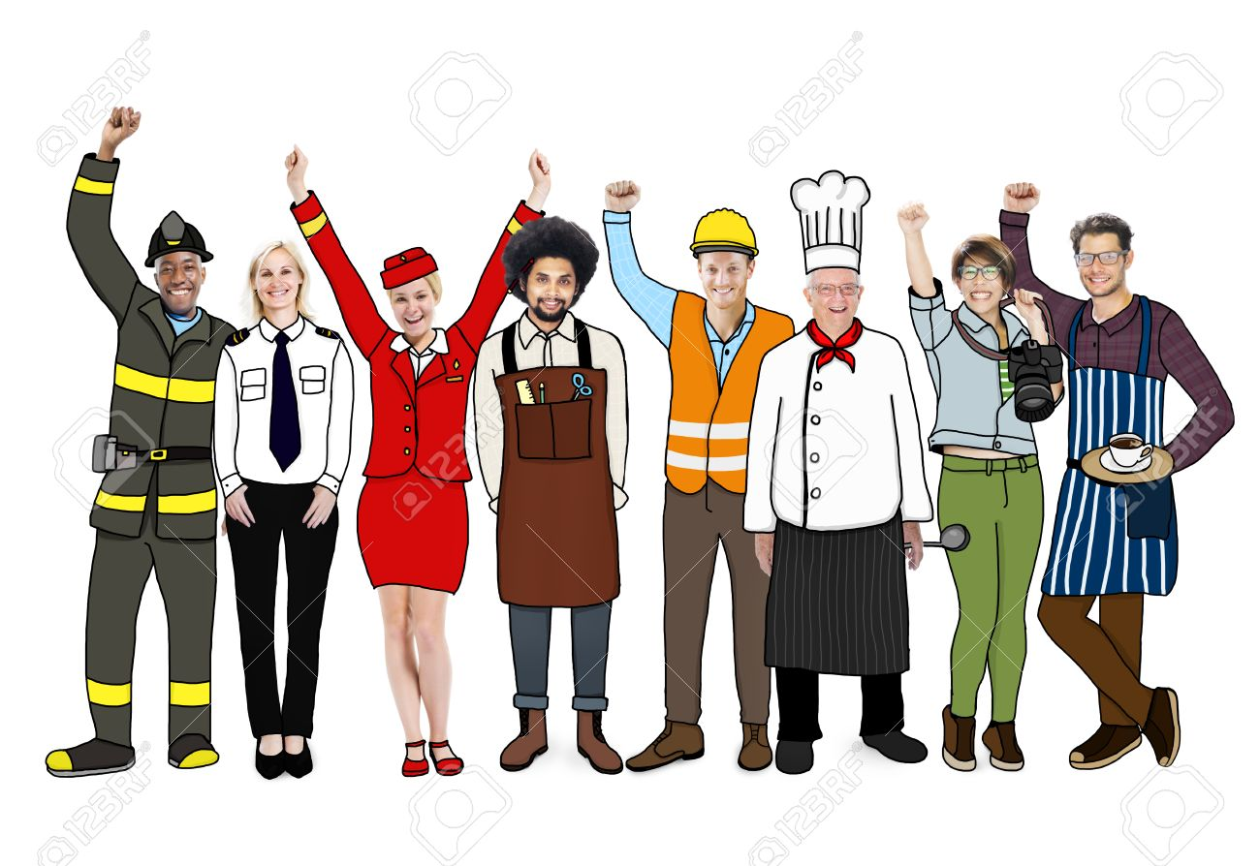
JOBS DIFINITION

Slide 77
Guess what job it is?

Slide 78
1. create lesson plans and teach those plans to the entire class to students or in small big groups, track student progress and present the information to parents, create tests, create and reinforce classroom rules, work with school administration prepare students for standardized tests, and manage.

Slide 79
2. plan and provide medical and care to patients in hospital, at home or in other settings who are suffering from chronic or acute physical or mental ill health

Slide 80
3. examine, diagnose and treat patients. They can specialize in a number of medical areas, such as pediatrics, anesthesiology or cardiology, or they can work as general practice physicians. Also requires earning a doctoral degree in medicine and participating in clinical rotations.

Slide 81
4. are required to fly different types of aircrafts, such as helicopters and airplanes, in order to transport cargo and passengers across the world. They may work for passenger airlines and team up with another.

Slide 82
5. protects citizen by preventing crime; enforcing laws; apprehending suspects; monitoring traffic.

Slide 83
6. must behave in ways that demonstrate adherence to the U.S. Army's seven core values: loyalty, duty, respect, selfless service, honor, integrity and personal courage.

Slide 84
7. is an appointed or elected magistrate who presides over court proceedings. A judge rules on questions of law acts as a referee between the litigating parties and renders decisions in legal disputes.

Slide 85
8. make their living by competing in sporting competitions. And the rest of the time is spent on the training ground or at the gym.

Slide 86
9. cut and trim meat from larger, wholesale portions into steaks, chops, roasts, and other cuts. They then prepare meat for sale by performing various duties, such as weighing meat, wrapping it, and putting it out for display.

Slide 87
10. a person who designs, builds, or maintains engines, machines, or public works.

Slide 88
11. greet passengers as they board the aircraft and direct them to their seats, assisting as needed.

Slide 89
12. manage the operations of their school, usually in elementary schools, middle schools, or high schools. ... They are responsible for ensuring their school runs smoothly, remains safe, and provides an excellent learning environment for its students.

Slide 90
13. is a supply chain management term that means anyone who provides goods or services to a company or individuals.

Slide 91
14. a person who repairs and maintains cars.

Slide 92
15. a person who is trained to travel in a spacecraft.

Slide 93
16. a person who cuts and styles hair as an occupation.

Slide 94
17. a person qualified to treat the diseases and conditions that affect the teeth and gums, especially the repair and extraction of teeth and the insertion of artificial ones.

Slide 95
18. a person who installs and repairs the pipes and fittings of water supply, sanitation, or heating systems.

Slide 96
19. a person whose profession is acting on the stage, in movies, or on television.

Slide 97
20. a person who reads broadcast news stories.

Slide 98
ANSWER
Teacher 11. Flight Attendant
Nurse 12. Principal
Doctor 13. Vendor
Pilot 14. Mechanic
Police officer 15. Astronaut
Soldier 16. Hair Dresser
Judge 17. Dentist
Athlete 18. Plumber
Butcher 19. Actor
Engineer 20. Newscaster

Slide 99
Answer in a complete sentence
What is a job?
Why job is important?
Why you choose this kind of job?
How can you help this kind of job to the community?
What is your second job option, and why?

